Slide 1
DISCUSSING SPECIFIC ENCOUNTERS FOR EASTERN EUROPEAN SCIENTISTS: INVOLVEMENT AND ACCESS TO MEA’S
A VARIETY OF REFLECTIONS BASED ON PRACTICE
Part 1: Dr. Ancuta Fedorca (Senior Researcher, National Institute for Research and Development Forestry Marin Dracea, Romania)
Part 2: Dr. Elena Buzan (Professor, University of Primorska, Slovenia)

Slide 2

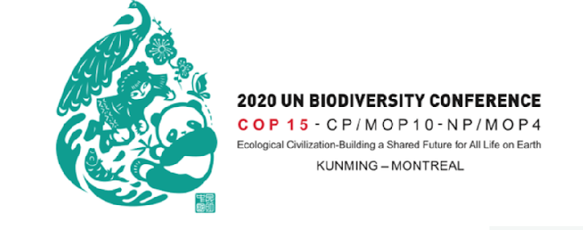
PART 1
NETWORKS, INDICATORS OF GENETIC DIVERSITY AND NBSAP
Dr. Ancuta Fedorca
Senior Researcher, National Institute for Research and Development Forestry Marin Dracea, Romania

Slide 3

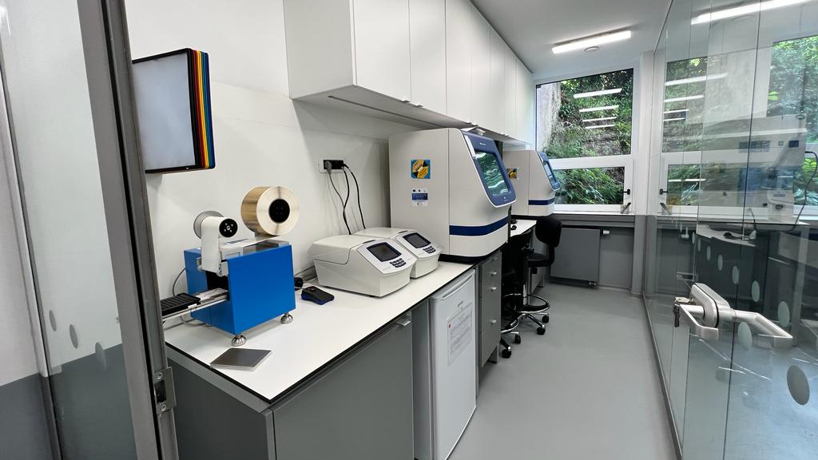
Who am I?
Molecular ecologist coordinator Wildlife Department – Molecular Genetics Lab at INCDS Marin Dracea Romania since 2012
I coordinate a team of 20 people working on population genetics and conservation management of large mammals
I am involved in making conservation genetics a practical tool to inform management actions
I was co-leading a WG2 in G-BIKE

Slide 4



https://g-bikegenetics.eu/en
NETWORKING – A CHANCE FOR AN EASTERN EUROPEAN SCIENTIST
G-BIKE (2019-2023)
43 countries and other associated partners more than 120 participants (scientists and practioners)
Workshops, Trainings, Exchanges, Short Term Scientifc Missions, Virtual Mobility Grants, Conferences, Meetings
Leadership and co-leadership for researchers from Eastern Europe countries
A unique opportunity for to be involved with CBD National Focal Points, COP15 and other policy
G-BIKE continues working with >30 active collaborators: SBSTTA and COP16 – providing advice and support to countries at CBD
Notes:
G-BiKE is a network of researchers and practitioners enlarging the scope of a previous EU-funded project, ConGRESS. G-BiKE has enabled standard and routine tools for assessing, monitoring and managing the genetic resilience and related adaptive potential of wild and captive populations.
G-BIKE had a balanced representation of scientists and practitioners from a diversity of countries

Slide 5

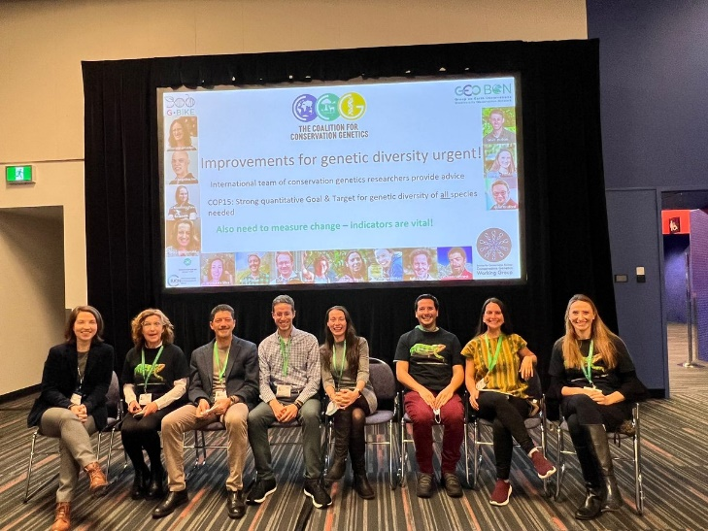

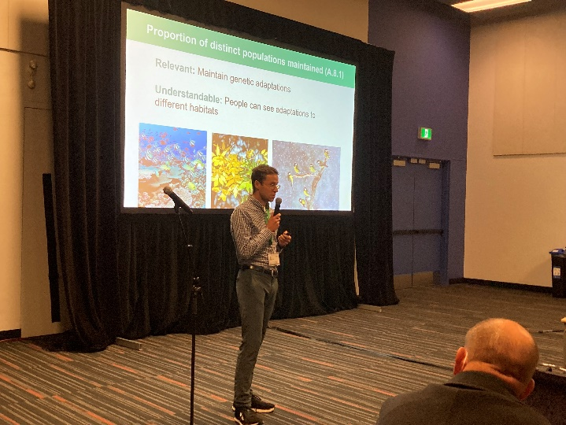

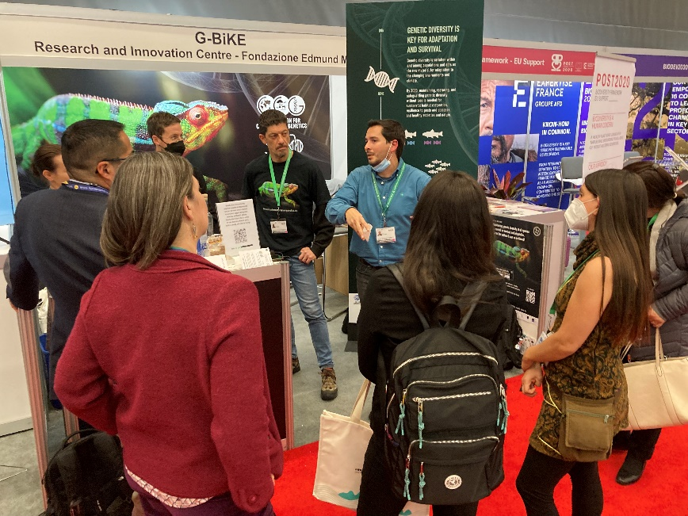
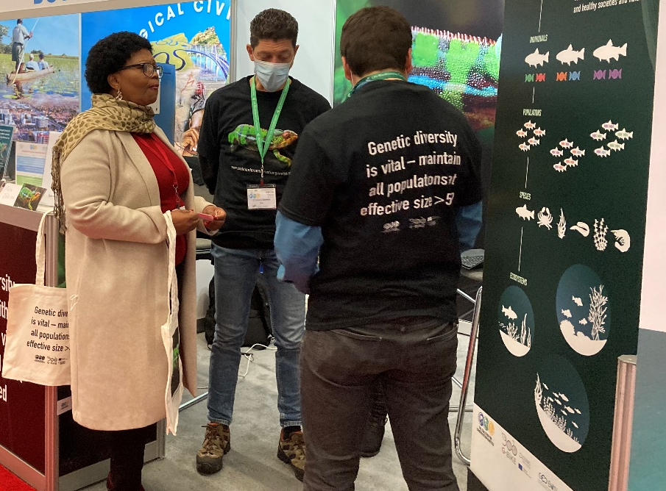
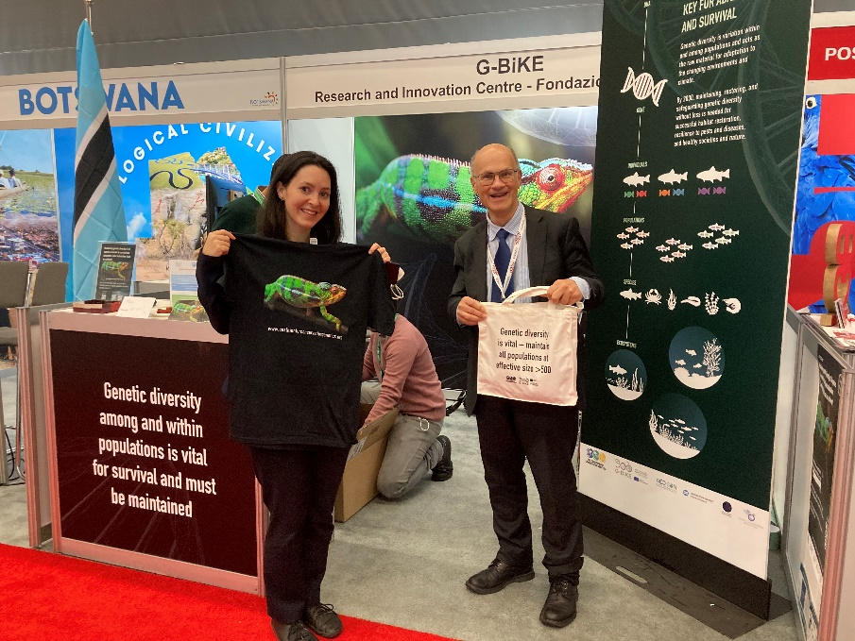
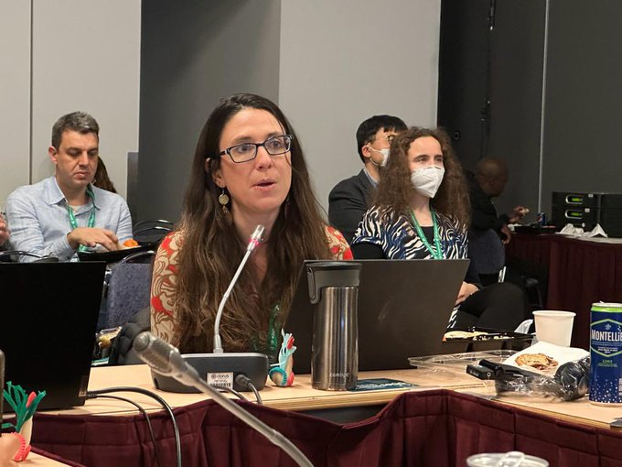
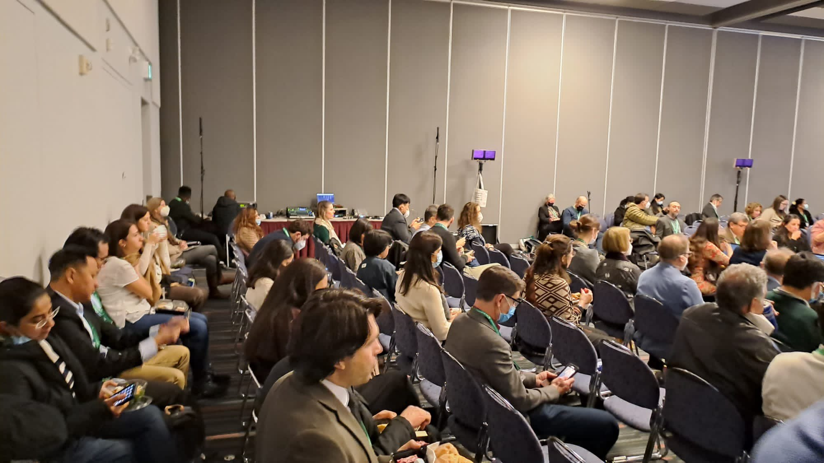
Initiatives: Activities during COP15
Helped wording of the genetic Target and indicators
Side-event seminar >100 participants in person, >100 online
Information booth
Direct contacts with NFPs, media, webpage, social media, etc.
Notes:
G-Bike and the Coalition for Conservation Genetics attended COP15 in Montreal and helped with the wording of the Genetic Target and indicators

Slide 6





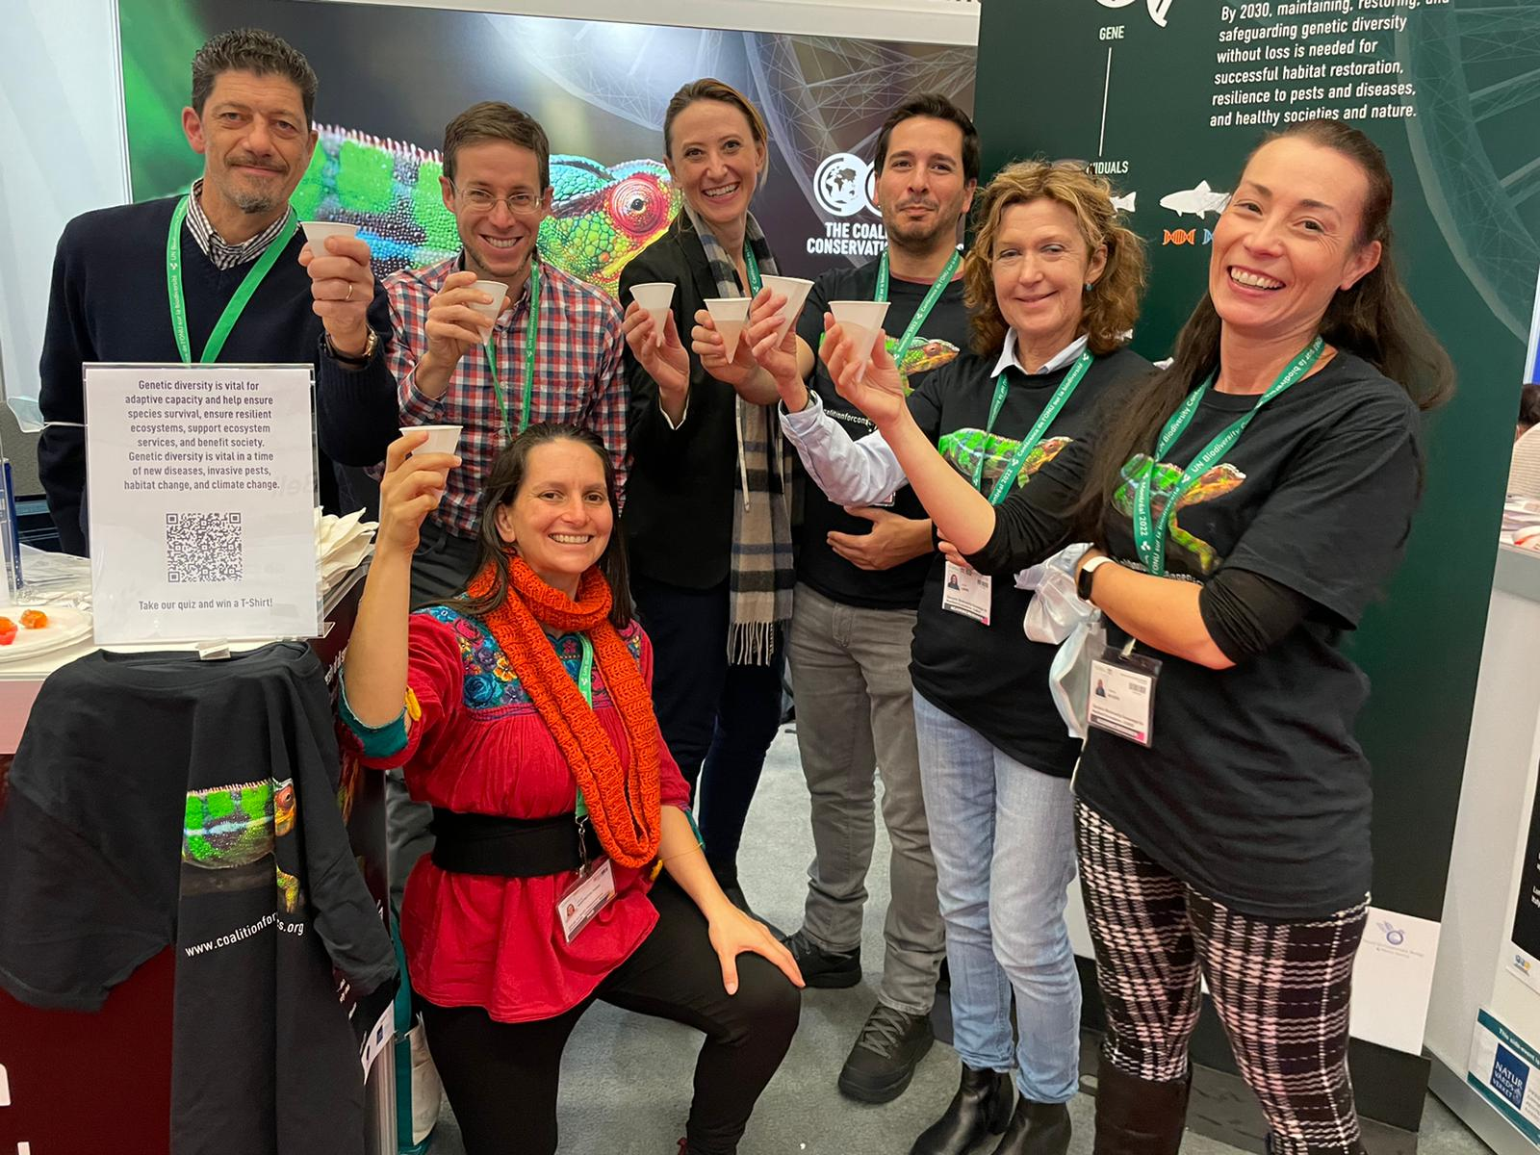








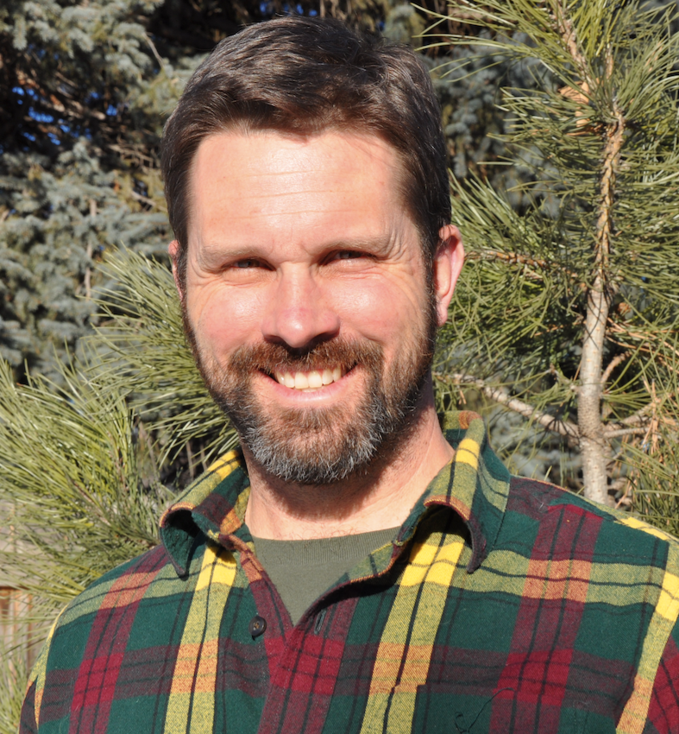

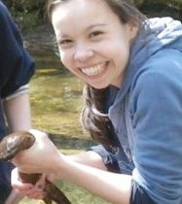

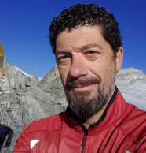

Catherine Grueber
Sean Joban
International team of conservation genetics researchers joined forces to provide advice to CBD policy makers
Gernot Segelbacher
Maggie Hunter
Francine Kershaw
Improvements for genetic diversity urgent!
Mike Bruford
Anna MacDonald
Also need means to measure change – indicators are vital!
Alicia Mastretta-Yanes
Robyn Shaw
David O´Brien
Mariah Meek
Cinnamon Mittan
W. Chris Funk
Rob Ogden
Cristiano Vernesi
Notes:
Proposed wordings for Goal, Targets, Indicators for genetic diversity
Scientific papers, Statements to CBD Secretariat and National Focal Points (NFPs), Reviews of CBD documents
Personal contacts with NFPs,
Webinars for NFPs,
Direct contacts with key CBD policy makers,
Attending CBD meetings – support to NFPs,
Guidance on how to assess our proposed indicators.

Slide 7
1. Case study of international collaboration –
measuring genetic diversity - with or without DNA data
Designation of several indicators using DNA data OR using proxies, getting at genetic processes without DNA-based genetic data – using available data with an affordable, inclusive approach
Indicator PM
The proportion of Populations Maintained within species
Indicator Ne 500
The proportion of populations within species with an effective population size (Ne) > 500
Indicator DNA-monitoring
The number of species in which genetic diversity is being monitored with DNA-based methods for at least one population
There are other useful complementary genetic indicators which are not mentioned in this case study
Hoban et al 2020, Laikre et al 2020, Hoban et al 2021, Laikre et al 2021, O’Brien et al 2022, Frankham 2022, Hoban et al 2023 a, b
Notes:
To derive reliable indicators we should ask, how do we maintain genetic diversity and the ability for species to adapt? There are at least three things to ensure
Maintain sufficiently large populations to prevent loss of diversity within populations
Prevent loss of populations and their local genetic adaptations
And monitor genetic change directly to inform management actions

Slide 8











Nine countries pilot
  Goal of 50-100 species per country
    Australia, Belgium, Colombia, France, Japan, Mexico, South Africa, Sweden, USA
  Working with personnel in biodiversity agencies
  A data collection form for entering (KoboToolbox)
    Each population’s Nc, Ne, or both
      Extant and extinct populations
      Other species information
Controlled vocabulary, rules for data entry, brief explanations on what is needed and linked to a detailed manual.
In the next phase we plan to include Eastern Europe countries
Hoban et al 2023. Monitoring status and trends in genetic diversity for the Convention on Biological Diversity: An ongoing assessment… Cons Lett
Mastretta-Yanes et al 2023. Multinational evaluation of genetic diversity indicators for the Kunming-Montreal Global Biodiversity Monitoring framework. Pre-print https://ecoevorxiv.org/repository/view/6104/
Notes:
The case studies shows that Parties can leverage national databases for reporting on at least tens of carefully chosen, representative species per country
In addition, we are working to develop global and scalable decision support tools, including databases, and workflows
8

Slide 9
Summary of findings
919 species and >5000 populations’ data
More than 80% of species had data for at least one indicator
Main conclusions
  Many populations are too small to maintain genetic diversity. Species’ populations need restoration and management (to increase the indicator)
  Most species maintain most populations – for now. We must prevent further losses (keep indicator value high)
Multinational evaluation of genetic diversity indicators for the Kunming-Montreal Global Biodiversity Monitoring framework
-ecoevorxiv, https://ecoevorxiv.org/repository/view/6104/
Notes:
As you know, genetic diversity has been a part of the CBD framework since the beginning, and there were previously Targets for genetic diversity, shown here

Slide 10
The results of a 9-country pilot study showed
Genetic diversity indicators
                feasible at scale
                leveraging on country biodiversity efforts (e.g. Red Listing, local and national nature management)
                working for all types of species
                making genetic monitoring affordable, inclusive, accessible, and useful
                highlight critical conservation message
                helped with genetic capacity on assessing species for which there are no genetic studies

Slide 11
2. Case study on National Biodiversity Strategies and Action Plans - Kunming-Montreal Global Biodiversity Framework
Laikre et al. 2010 showed that genetic diversity conservation had been neglected both in NBSAPs and in National Reports
International collaboration advice from many people around world
NBSAPs should
    have high-level support from policy makers as a product of cross-ministerial cooperation
    include actions that can help maintain and restore genetic diversity, tailored to each country’s capacity
    co-development with communities to foster widespread societal ownership and investment in biodiversity
    include monitoring, evaluation and review, including choice of appropriate indicators
Notes:
Those are the indicators
The case studies in the second part of the webinar will show that Parties can leverage national databases for reporting on at least tens of carefully chosen, representative species per country
In addition, we are working to develop global and scalable decision support tools, including databases, and workflows
11

Slide 12
National Biodiversity Strategies and Action Plans - Kunming-Montreal Global Biodiversity Framework
Why is it important?
Current work Hoban et al. 2024 builds guidance in how NBSAPs should include greater recognition and conservation of genetic diversity (GBF Goal A Target 4)
Genetic diversity
Plans
Concerns
Capacity
Policy
Commitments
Notes:
Those are the indicators
The case studies in the second part of the webinar will show that Parties can leverage national databases for reporting on at least tens of carefully chosen, representative species per country
In addition, we are working to develop global and scalable decision support tools, including databases, and workflows
12

Slide 13
Eastern Europe in the context of CBD and GBF
Capacity building – international cooperation and cross-ministerial-experts cooperation, supporting genetic diversity assessments for conservation problems and greater recognition of conservation of genetic diversity in NBSAP;
Raise awareness about the value and importance of genetic diversity in key stakeholder groups;
Promote transnational mutual experience exchange, and the active participation of Eastern European countries;
Build genetic monitoring programmes with long-term allocation of resources not limited to a project lifespan;

Slide 14
PART 2: MONITORING OF GENETIC DIVERSITY
ACCESS AND BENEFIT SHARING
Dr. Elena Buzan
Professor, University of Primorska, Slovenia

Slide 15


UNIVERSITY OF
PRIMORSKA
FACULTY OF MATHEMATICS,
NATURAL SCIENCES AND INFORMATION TECHNOLOGIES

Slide 16
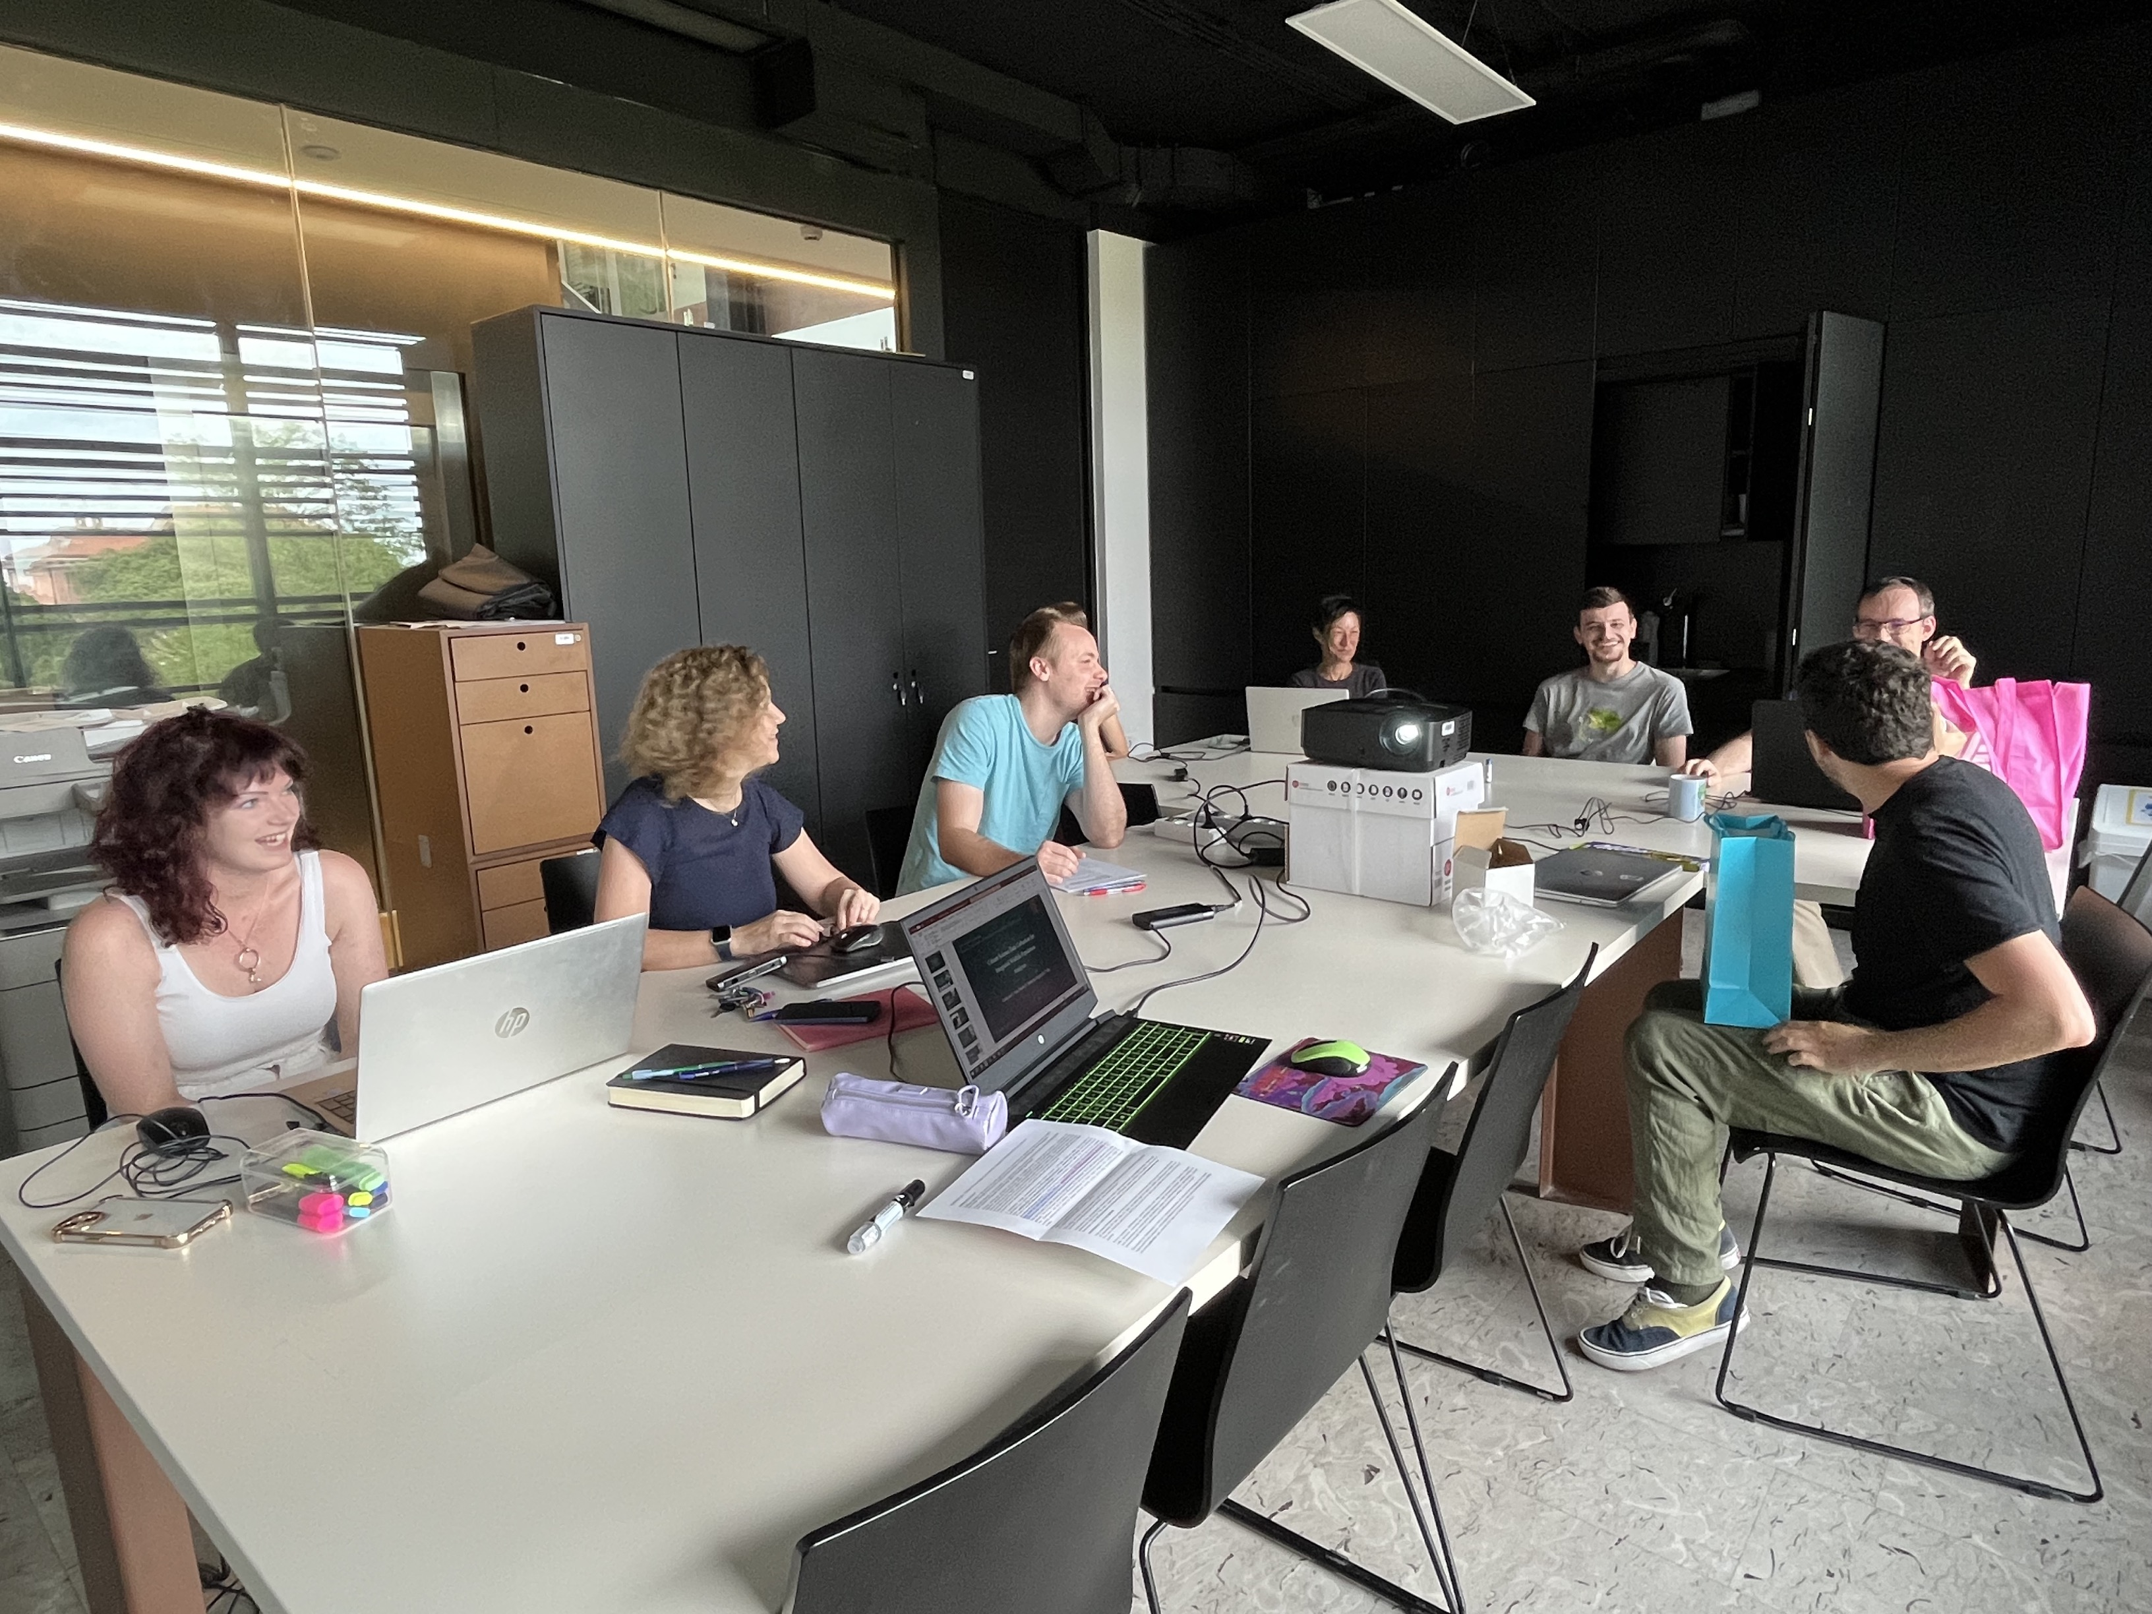
Molecular and Computational Ecology
Faculty of Mathematics, Natural Sciences and Information Technologies
Applying molecular techniques to wildlife ecology, management, and conservation
Understanding how citizen science can complement data collection about genomic/genetic information, which can assist conservation policymaking
H2020 Step Change and BEPREP, HE Biodiversity genomic Europe, and ProCoast
Fully equipped for genomics
Follow us on Twitter @MolecularEcolUP

Slide 17
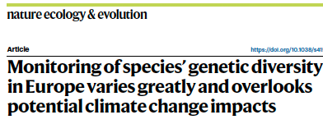
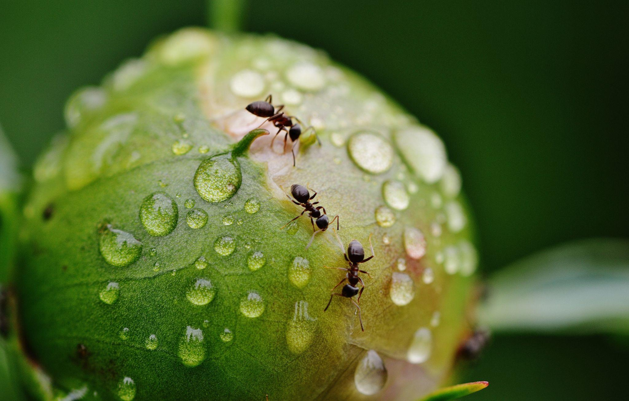
Maintenance of wild population genetic diversity (PGD)
development of indicators of genetic diversity
Screen where the monitoring of PGD is being conducted across Europe
Identified populations near the hot–dry limits of species’ ecological distributions
Pearman et. al. 2024

Slide 18
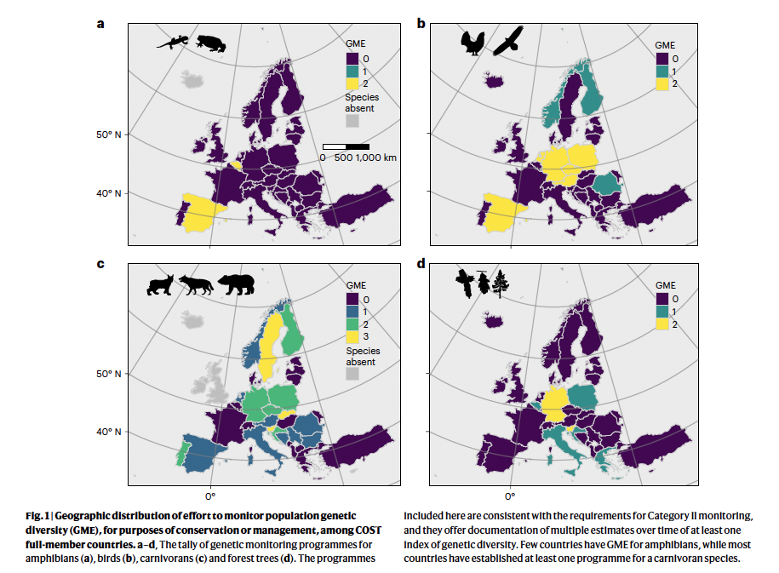
Methods
38 countries and 518 candidate monitoring studies
At the end 151 national-level monitoring studies were eligible
Monitoring efforts
Vary greatly among European countries
Strong taxonomic bias in monitoring programmes

Slide 19
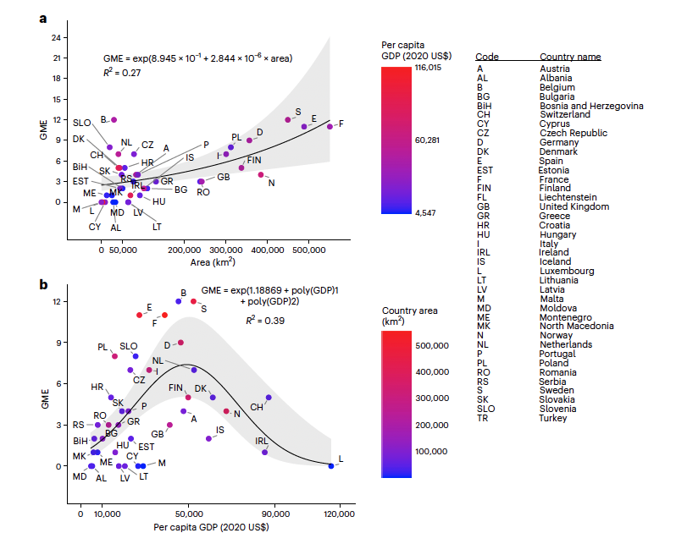
Genetic monitoring effort
Conclusion:
Monitoring effort needs to be expanded — especially in south-eastern Europe
The eastern Adriatic coast, central Turkey and the Carpathian Mountains can serve as foci for international, cooperative monitoring programmes.
Genetic monitoring efforts of COST full-member countries as a function of area per capita GDP.
Notes:
Populations - to be first affected by climate change
a,b, Generalized linear models for the GME of COST full-member countries, represented by international postal codes, as a function of area (a) and per capita GDP (b).
rger countries
tend to have higher GM In contrast, intermediate GDP is associated with greater GME
(Fig. 2b; negative binomial regression, GDP quadratic term P = 0.003;
Appendix 2, Supplementary Information). Substantial residual variation
remains, with Austria, Finland, Norway and the United Kingdom
among those countries having fewer projects than expected, and
Belgium and Sweden more projects, in relation to both size and GDP
(Fig. 2b). The negative quadratic relationship of GME with GDP remains
statistically significant with the omission of data from any single outlier
or extreme value (Switzerland, Ireland or Luxembourg; Appendix 2,
Supplementary Information).

Slide 20

Guidelines for future Monitoring efforts
Broadened beyond narrowly focusing on flagship species such as large carnivores.
Include amphibians, forest trees, and others, that are likely to suffer severe impacts from climate change.
Neutral genetic markers and indicators can be enhanced with genome-wide study of adaptive genetic diversity.

Slide 21

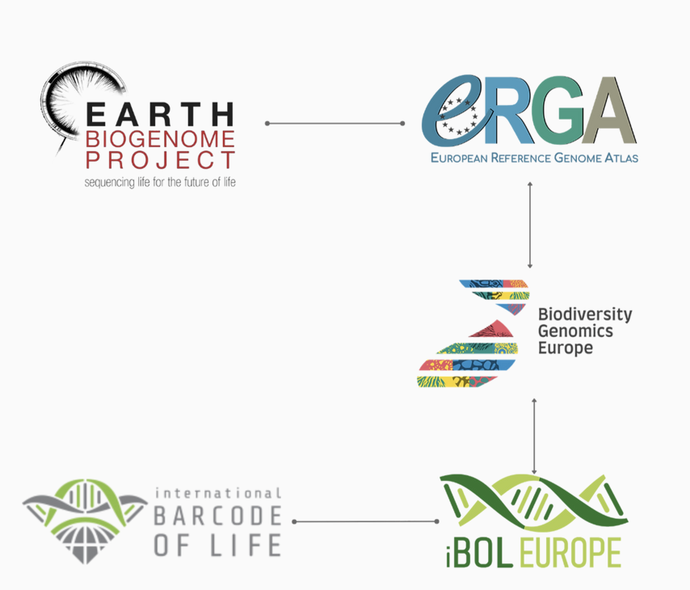
GENOMICS
COMMUNITIES
Capacity
Establish functioning biodiversity networks at the European level
Production
large-scale biodiversity genomic data generation pipelines for Europe
Application
Apply genomic tools to enhance understanding of pan-European biodiversity and biodiversity declines
Notes:
Just to give orientation – the BGE project supports the European endeavours of two major global programmes – the International Barcode of Life or iBOL project – using short standardised regions of DNA for high-throughput species identification –, and the Earth Biogenome project focusing on the large scale production of reference genomes providing insights into genetic and genomic diversity.
As I am focusing on the barcoding side (CLICK) of BGE– I am going to start by summarising the aims of global International Barcode of Life

Slide 22
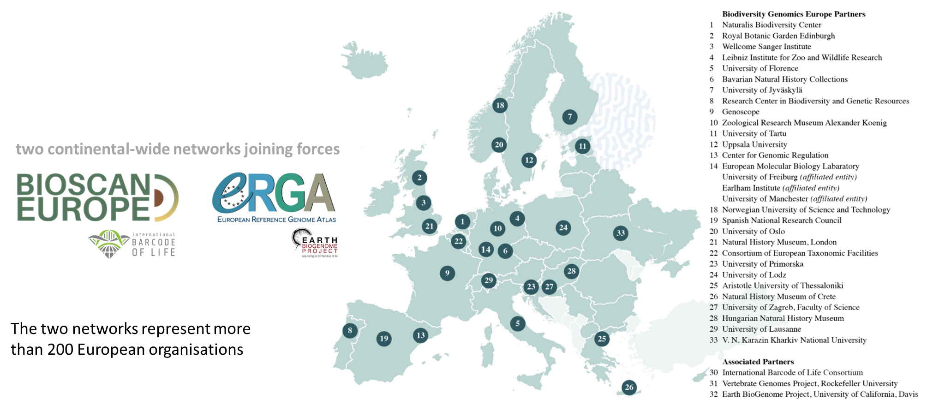

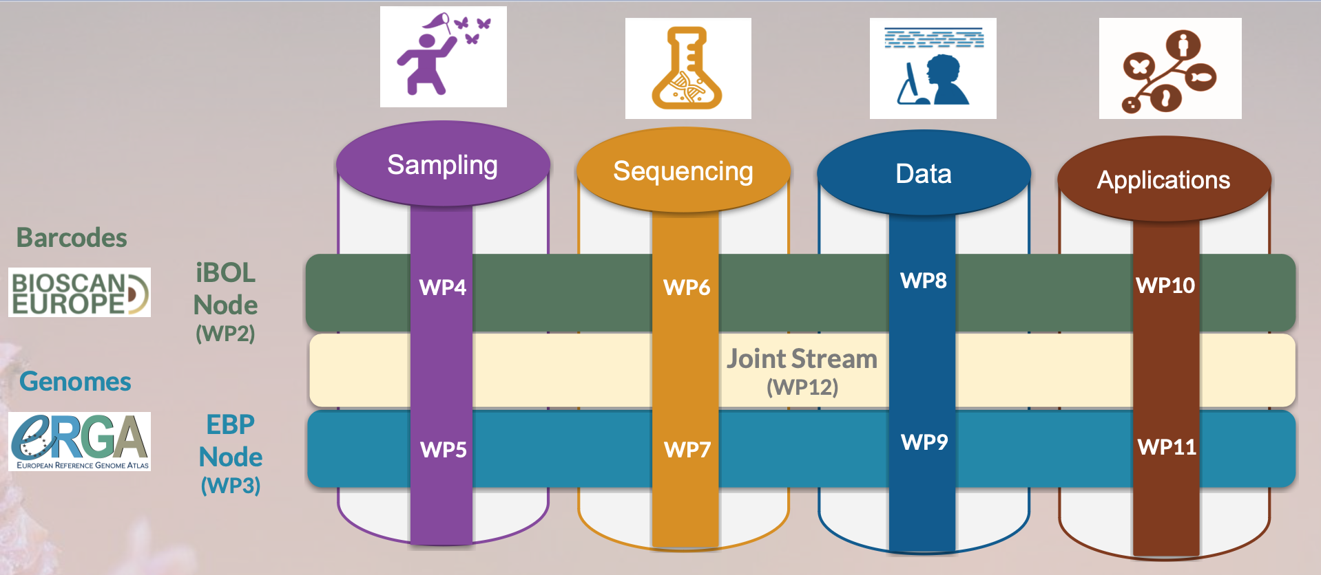

@BioGenEurope biodiversitygenomics.eu

Slide 23







> 1000 Europe-based scientists
>200 Research Institutions
39 countries
Biodiversity Sequencing
BioGenome Applications
Genomics for Society
Distributed across Europe and the Eukaryotic Tree
From Critical Biodiversity and Biodiversity Hotspots
New collaborative Networks
SOPs development
Analysis toolkits
Genomics training
Knowledge sharing platform
>500 genomes
Knowledge
sharing
Sequencing Centres
Computational
Training
Molecular labs
Consolidation as EBP Regional node
Plan scaling up reference genomes production
Multi-national infrastructure
EBP European node

Slide 24
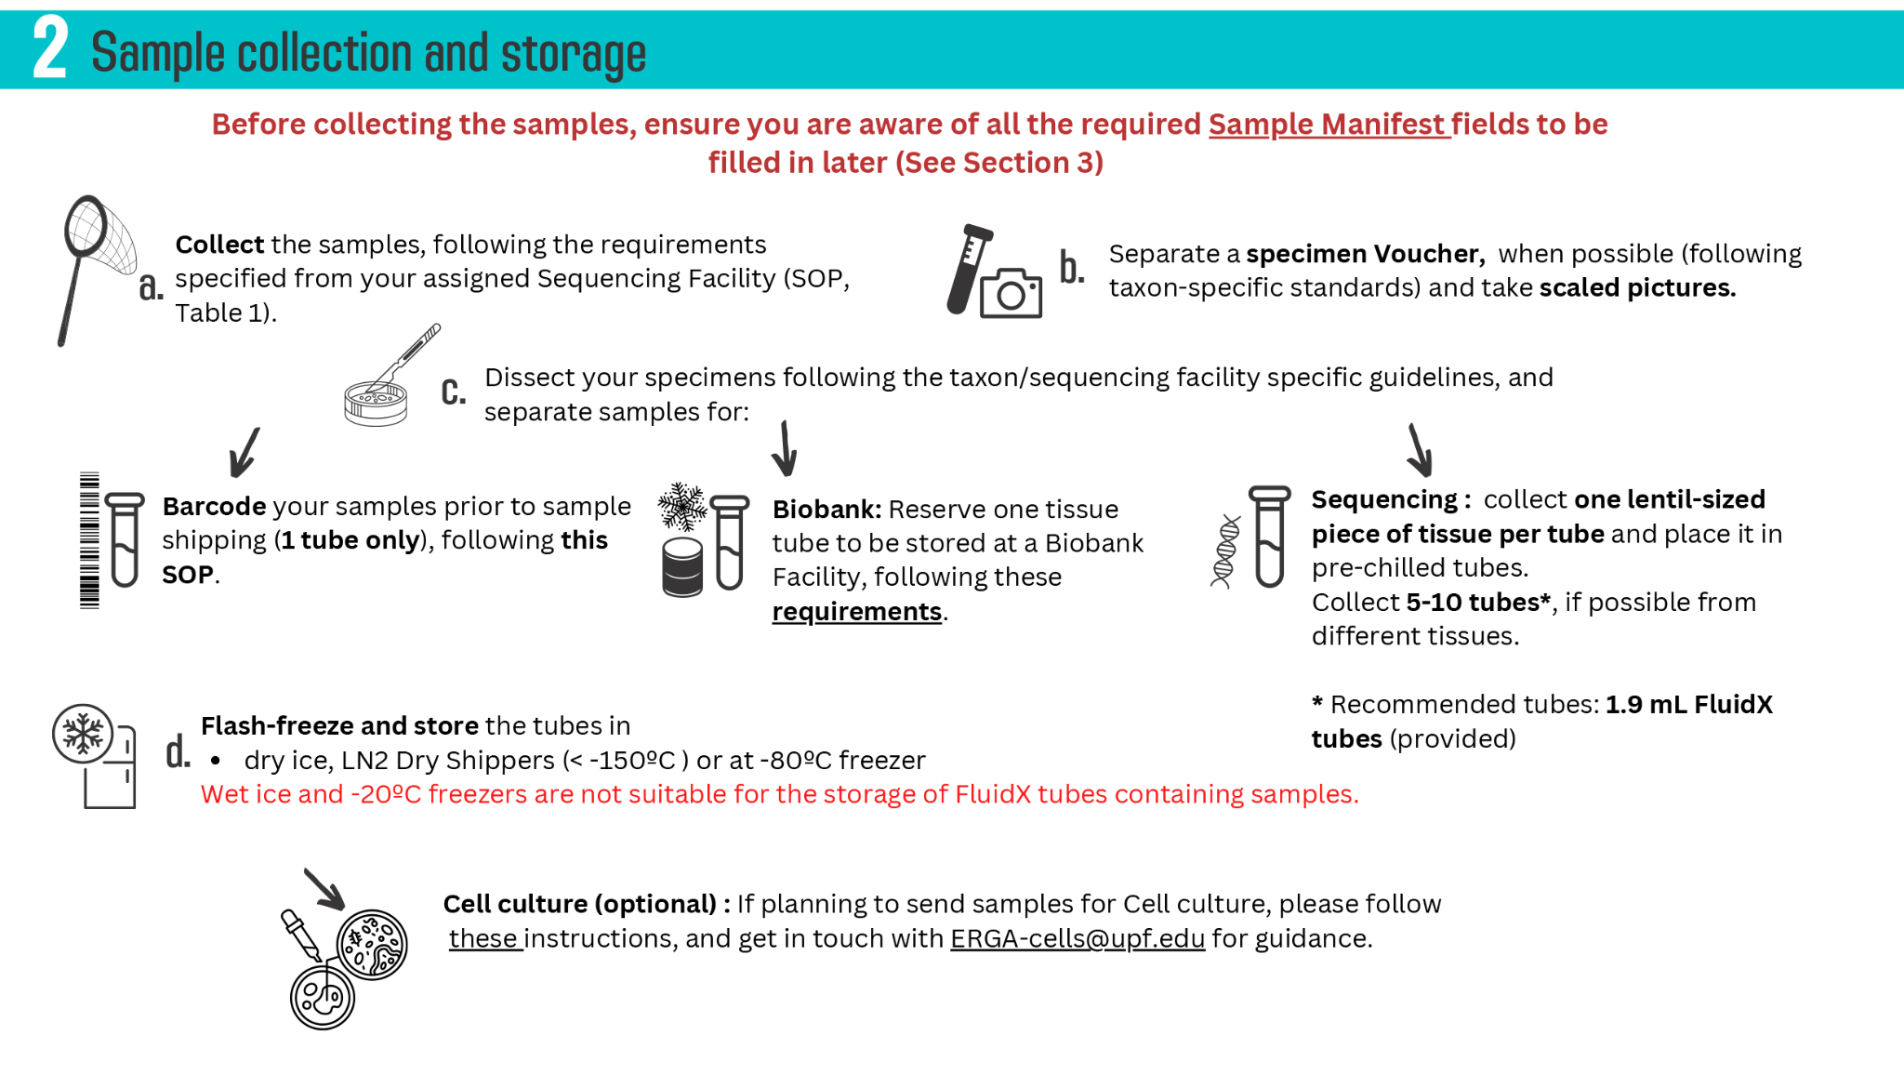
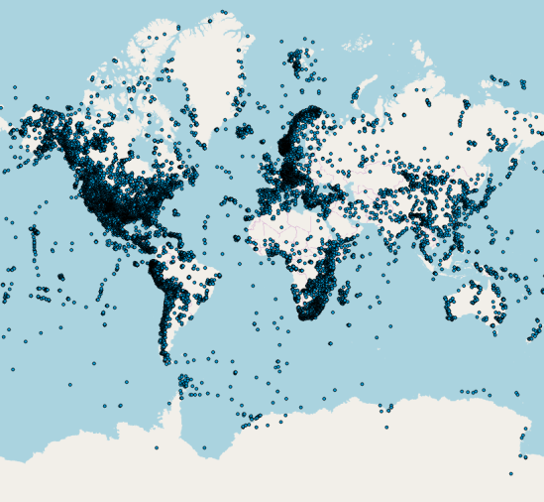

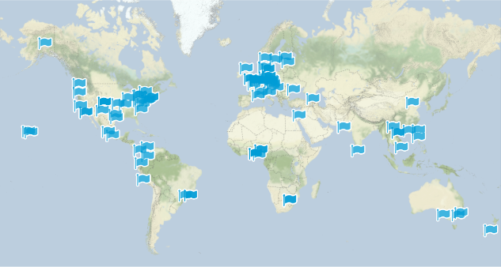
Vouchering / Biobanking
>5M samples
Global Genome Biodiversity Network (GGBN.org)
Eastern European Countries
Lack of infrastructure
deposition of Molecular vouchers (DNA, tissue, or cells) in biobanks is not yet as established
>110 members
~40 countries

Slide 25
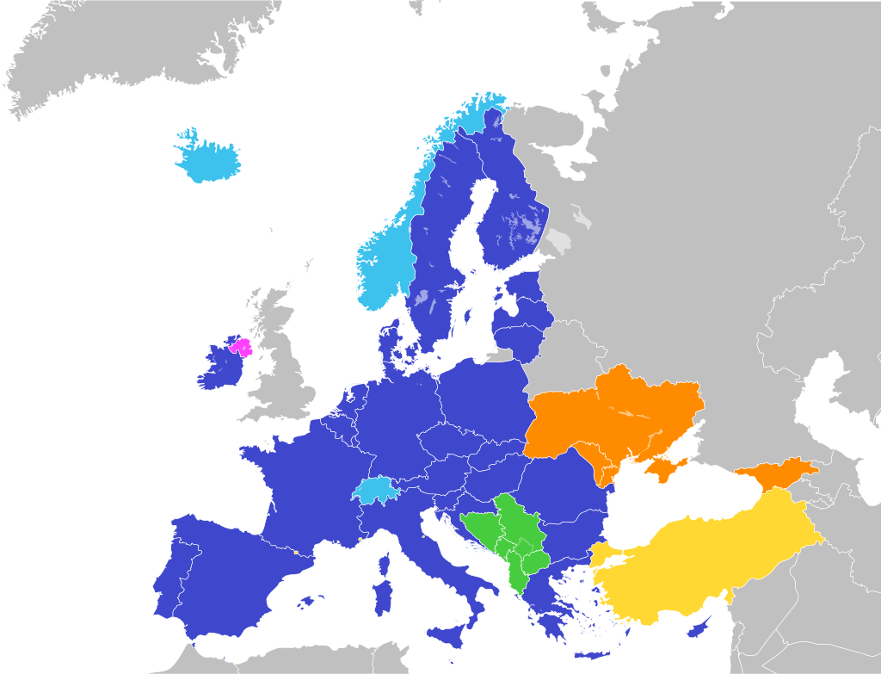
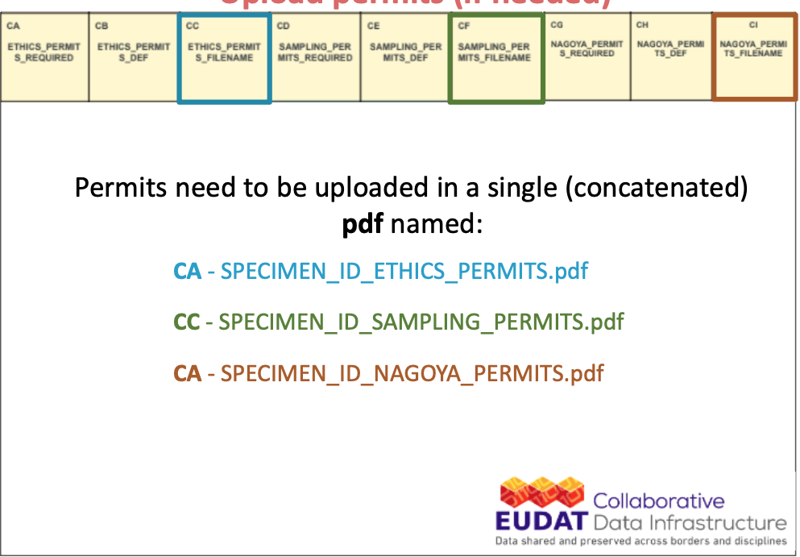
Eastern European Countries
Not members of EU
Lack of guidelines for
Sampling permits
Ethics permits (not yet established)
EU Regulations and Directives are applicable in all EU 27 Member States
all Countries of the Schengen Area, i.e. Switzerland, Norway and Island
in Northern Ireland
and may be aligned with national laws in further non-EU Countries

Slide 26
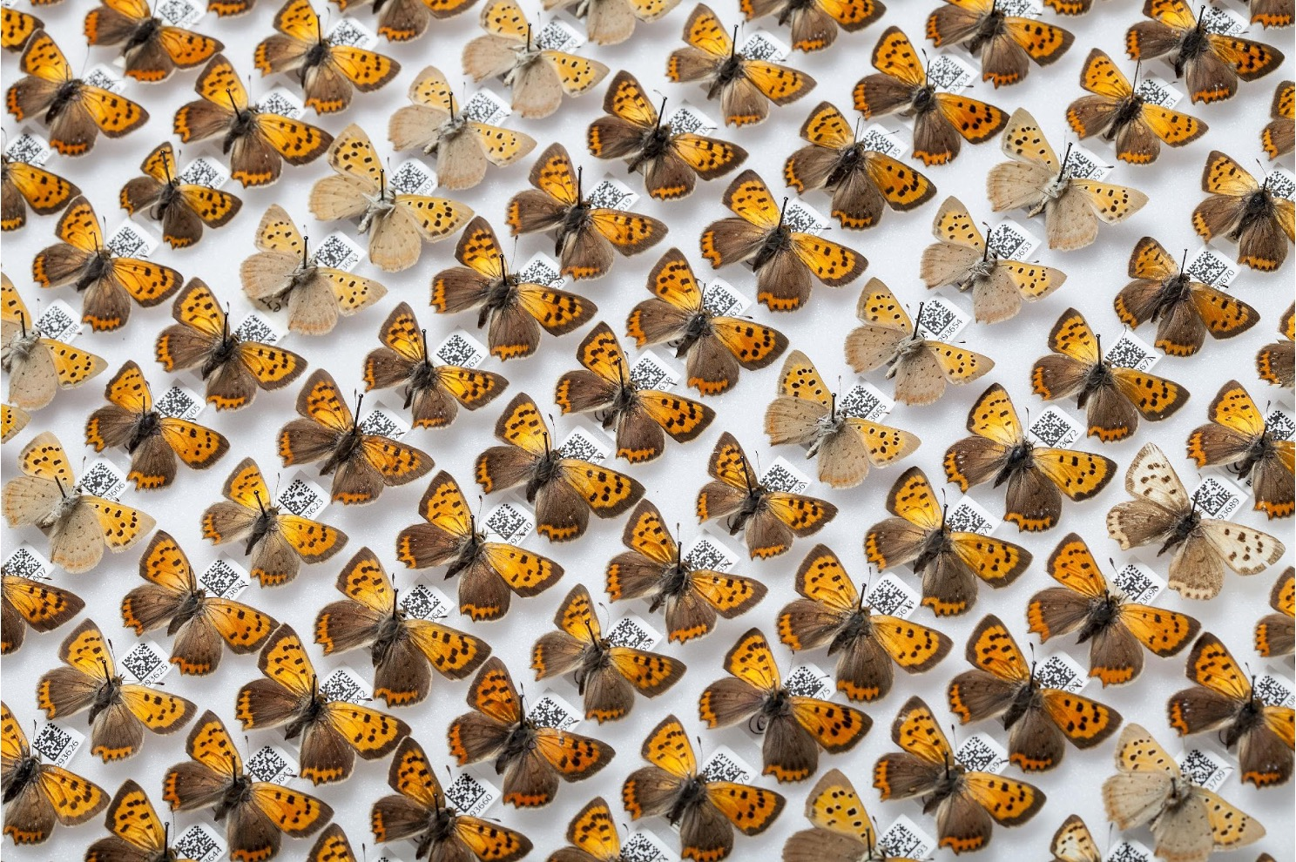
Access and Benefit-sharing (ABS)
benefit-sharing should contribute to conservation and sustainable use of biodiversity
DILIGENCE OBLIGATIONS OF THE EU ABS Regulation, Art 4 (1) (EU) No 511/2014
Date and place where material was collected
Description and identification of the used material
Source where material was directly obtained
Relevant Permits (e.g. collecting, access, export, import permits)
Who is the responsible scientist for the samples
Where I can find samples and documents in 20 years
Eastern European Countries
Not members of EU (not obliged )

Slide 27
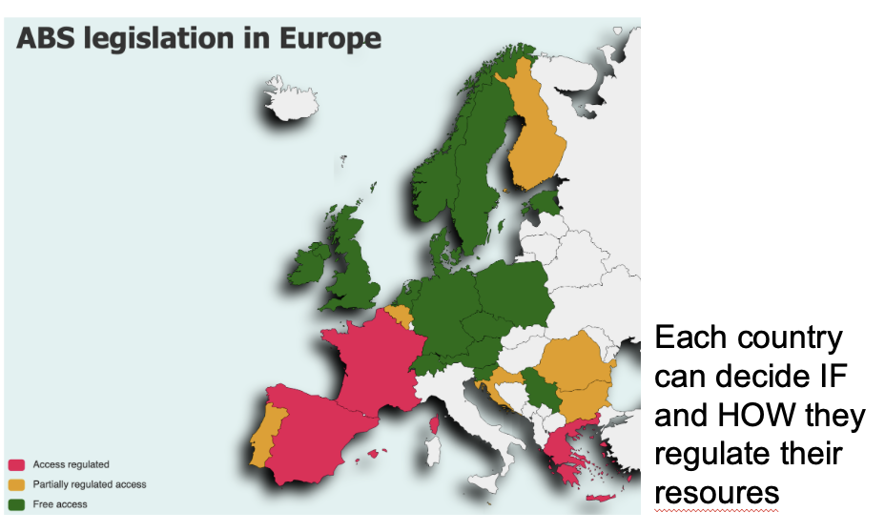
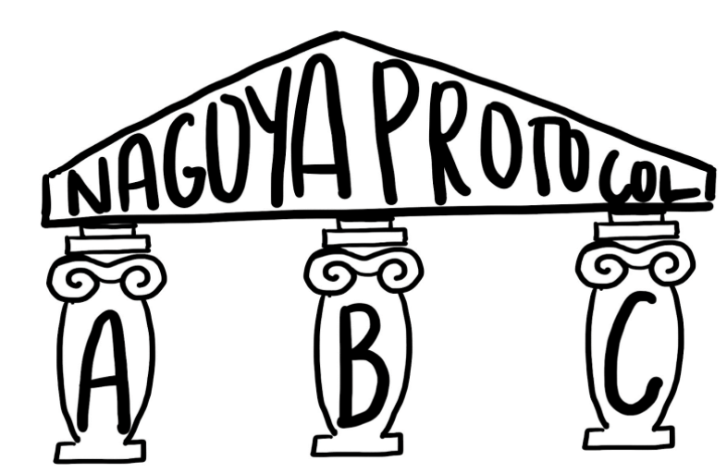

NOT implemented at EU Level – each state/Party decides if they establish rules, incl. EU member states
NAGOYA PROTOCOL
Eastern European Countries
More support needed from policy makers
Focal contact point
Subject to contractual agreements between provider country and user
ABS rules might precede the NP
Access date ≠ collection date
EU ABS regulation – due diligence obligations for all users

Slide 28
THANK YOU FOR YOUR ATTENTION!
Contact:
Ancuta Fedorca ancutacotovelea@yahoo.com
Elena Buzan elena.buzan@upr.si

Slide 29
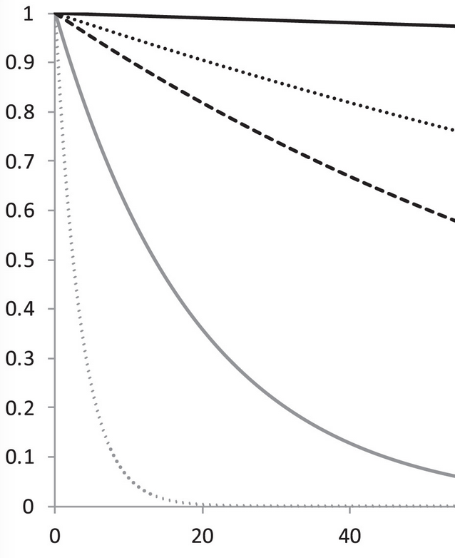
Explanation: Proportion of populations [or breeds] with
an effective population size (Ne) above 500
Below Ne 500, genetic diversity decreases quickly!!
Relevant: “Sufficiently large” to prevent genetic erosion/ inbreeding, and maintain adaptive capacity
Understandable: Already used in forestry (seed orchards), agriculture (breeds), fisheries (hatcheries)
Ne > 500
100
50
Genetic diversity
10
2
Time (generations) →
Figure modified from Willi et al 2021, PNAS
Notes:
Indicator 1 focuses on a well established threshold to prevent genetic erosion- much below an effective size of 500, genetic erosion is rapid, and much above this size and genetic erosion is slow or minimal.
Now, the CBD has used the concept of effective size for several decades- a threshold of effective size is how a domestic breed is declared threatened. Distinct populations are the wild equivalent of breeds, so we are just adapting the use of this very well accepted concept
It was G-BIKE and the Coalition and more than 20 people across globe who developed the indicators

