Slide 1
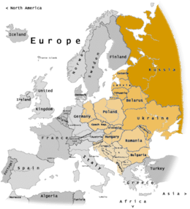
Biodiversity in CEE countries CBD challenges and opportunities for implementation in CEE Countries
PARIS CO-OP4CBD TRAINING
18-19 March 2024

Slide 2
CBD and its Protocols

Slide 3
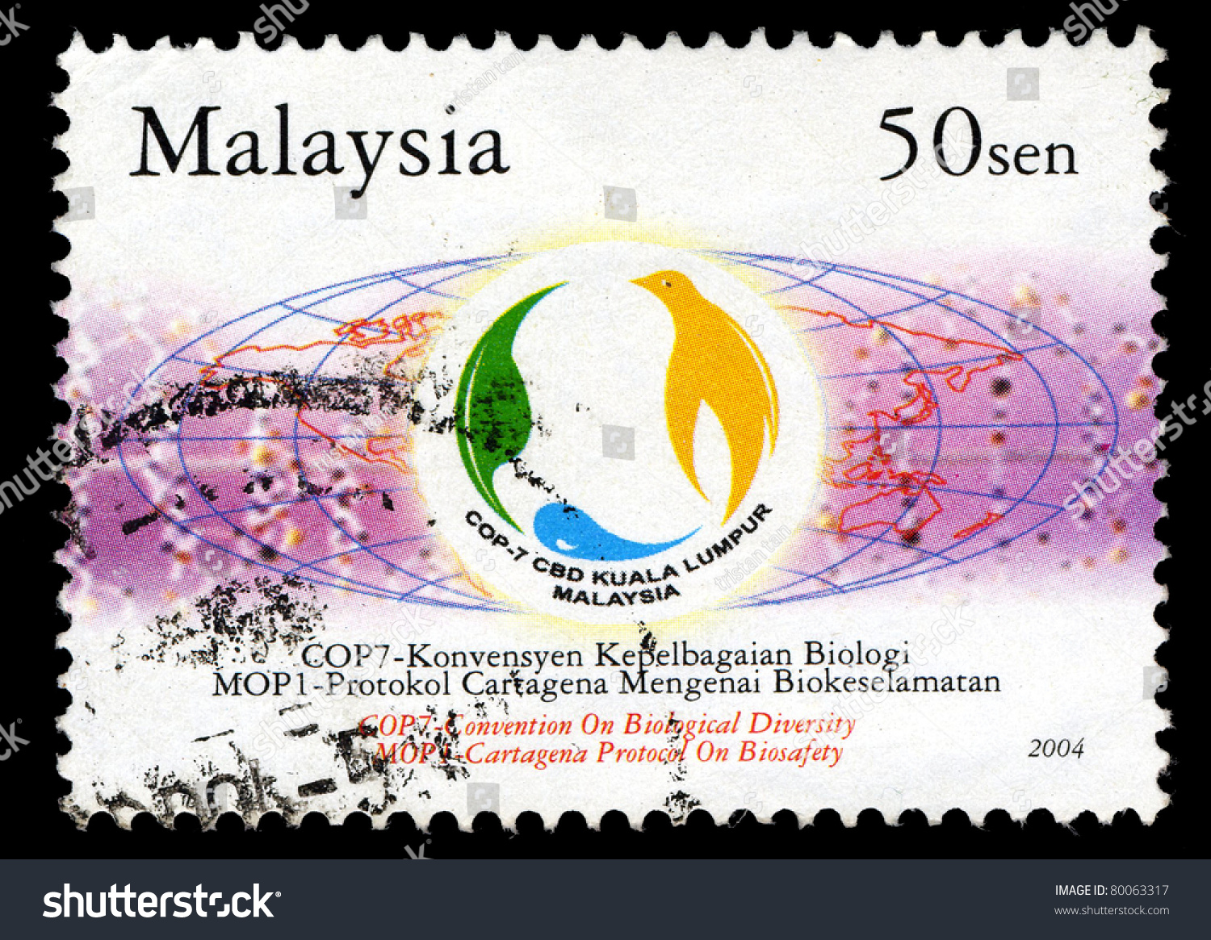

Slide 4
Convention bodies
Conference of the Parties (COP) -1 to 15 is the governing body of the Convention
Subsidiary Body on Scientific, Technical and Technological Advice (SBSTTA)
Subsidiary Body on Implementation
Working Group on Article 8(j) IPLC
Ad Hoc Open-ended Working Group on Protected Areas

Slide 5
COP Bureau MEMBERS President His Excellency Mr. Huang Runqiu China Represented by: Ms. Guomei Zhou China
Africa
Ms. Hlobsile Sikhosana, Mbabane, Eswatini Mr. Abderahmane Zino Izourar, Algiers, Algeria COP-MOP Nagoya Protocol substitute for Algeria: Mr. Moustafa Fouda, Cairo, Egypt
Asia&Pacific
Mr. Krishneel Nand, Suva, Fiji Ms. Somaly Chan, Phnom Penh, Cambodia CEE
Ms. Teona Karchava, Tbilisi, Georgia
COP-MOP Nagoya Protocol substitute for Georgia: Mr. Sino Tohirzoda, Dushanbe, Tajikistan Ms. Angela Lozan, Chisinau, Republic of Moldova
GRULAG
Ms. Gillian Guthrie, Kingston , Jamaica
COP-MOP Nagoya Protocol substitute for Jamaica: Mr. Jesus Guerra Bell, Havana, Cuba Ms. Maria Teresa Becerra Ramirez, Bogota, Colombia COP-MOP Nagoya Protocol substitute for Colombia: Ms. Corina Sarli, Buenos Aires, Argentina
WEOG
Mr. Eric Schauls, Luxembourg, Luxembourg Mr. Norbert Bärlocher, Berne, Switzerland EX-OFFICIO: SBSTTA Chair - Ms. Senka Barudanovic, Sarajevo, Bosnia and Herzegovina SBI Chair- Mr. Chirra Achalender Reddy, New Delhi, India

Slide 6
SBSTTA Bureau Chair Ms. Senka Barudanovic, Bosnia and Herzegovina
Africa
Mr. Jean Bruno Mikissa, Gabon
Mr. Kenneth Uiseb, Namibia
Asia & Pacific
Mr. Bilal Qtishat, Jordan
Mr. Md. Jahidul Kabir, Bangladesh
CEE
Prof. Taulant Bino, Albania
Mr. Jan Plesnik, Czechia
GRULAC
Ms. Aria St.Louis, Grenada
Ms. Mariela Cánepa Montalvo, Peru
Substitute for Nagoya Protocol for Grenada
Mr. Francis O. Reyes Polanco, Dominican Republic
WEOG
Mrs. Marina Von Weissenberg, Finland
Mr. Scott Wilson, Canada
Substitute for the Nagoya and Cartagena Protocols for Canada
Ms. Jane Stratford, United Kingdom

Slide 7
Platforms for CEE participations/science and regulation
COP-COP/MOPs – each 2 years
SBSTTA
SBI
Compliance committees
Liaison Group
Coordination Meeting for Governments and Organizations Implementing and/or Funding Biosafety Capacity-building Activities
CEE regional group meetings under the COP/COP/MOPs/SBSTTA`/regional statements
Contact groups, Friend of the chair
AHTEGs
On-line forums under the CHM: BCH on BCH forum, RA&RM, Sampling, Detection and Identification, BCH IAC.
Country’s submissions on topics
Country National reporting, thematic reporting, recordings to CHM Portal /BCH/ABS CH

Slide 8
Scientific and technical expert meetings
Ad Hoc Technical Expert Group on Indicators for the Kunming-Montreal Global Biodiversity Framework
Ad Hoc Open-ended Working Group on Benefit-sharing from the Use of Digital Sequence Information on Genetic Resources
Ad Hoc Technical Expert Group on Risk Assessment
Ad Hoc Technical Expert Group on Synthetic Biology to Support the Process for Broad and Regular Horizon Scanning, Monitoring and Assessment
Informal Advisory Group on Benefit-sharing from the Use of Digital Sequence Information on Genetic Resources
Informal discussions on digital sequence information on genetic resources
Informal Advisory Group on Technical and Scientific Cooperation
Informal Advisory Committee to the Access and Benefit-sharing Clearing-House
Informal Advisory Committee on Resource Mobilization
Compliance Committee under the Nagoya Protocol on Access and Benefit-sharing
Compliance Committee under the Cartagena Protocol on Biosafety
Subregional dialogue on national biodiversity strategies and action plans
Liaison Group on the Cartagena Protocol on Biosafety

Slide 9
Mechanisms for Implementation
National Biodiversity Strategies and Action Plans (NBSAPs)
National Reports
Cooperation and Partnerships
Financial Resources and Mechanism
Clearing-House Mechanism
Biosafety Clearing-House
LifeWeb for Financing Protected Areas

Slide 10
COP 15 CBD Decisions
Decision 15/4 Kunming-Montreal Global Biodiversity Framework
Decision 15/5 Monitoring framework for the Kunming-Montreal Global Biodiversity Framework
Decision 15/7 Resource mobilization
Decision 15/9 Digital sequence information on genetic resources
Decision 15/16 Knowledge management and the clearing-house mechanism
Decision 15/23 Sustainable wildlife management
Decision 15/24 Conservation and sustainable use of marine and coastal biodiversity
Decision 15/27 Invasive alien species
Decision 15/28 Biodiversity and agriculture
Decision 15/30 Biodiversity and climate change
Decision 15/31 Synthetic biology

Slide 11
COP/MOPs Decisions
COP/MOP 10 Cartagena Protocol
COP/MOP 4 ABS Nagoya Protocol
Decision 10/5 Operation and activities of the Biosafety Clearing-House (Article 20)
Decision 10/10 Risk assessment and risk management (Articles 15 and 16)
Decision 10/11 Detection and identification of living modified organisms
Decision 10/12 Socio-economic considerations (Article 26)
Decision 10/13 Nagoya – Kuala Lumpur Supplementary Protocol on Liability and Redress
Decision 4/4 Access and Benefit-sharing Clearing-House and information sharing (Article 14)
Decision 4/6 Digital sequence information on genetic resources
Decision 4/7 Measures to assist in capacity-building and development (Article 22) and awareness-raising (Article 21)
Decision 4/10 Global multilateral benefit-sharing mechanism (Article 10)

Slide 12
Central and Eastern European Region -23 countries
Albania | Estonia | Republic of Moldova
Armenia | Georgia | Romania
Azerbaijan | Hungary | Russian Federation
Belarus | Latvia | Serbia
Bosnia and Herzegovina | Lithuania | Slovakia
Bulgaria | Montenegro | Slovenia
Croatia | North Macedonia | Ukraine
Czechia | Poland

Slide 13
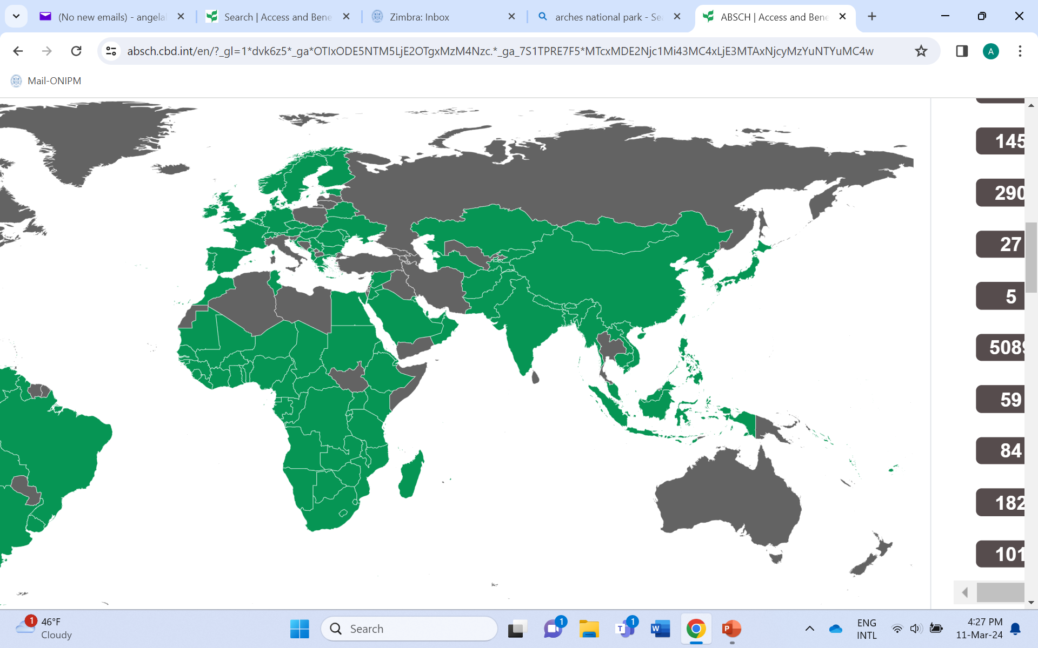
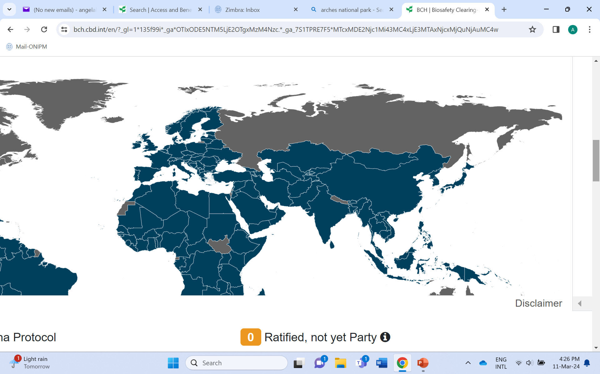
CEE Parties to the CBD, CPB, ABS, NKSPLR
CBD – 23 countries
CPB – 22 countries
ABS – 11 countries
NKSPLR - 11 countries

Slide 14
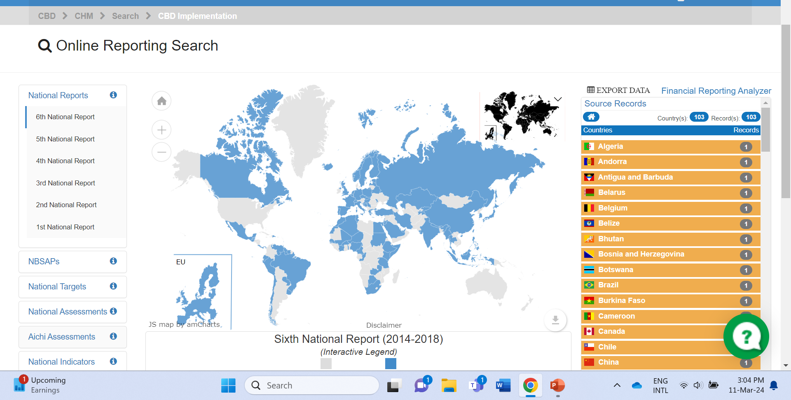
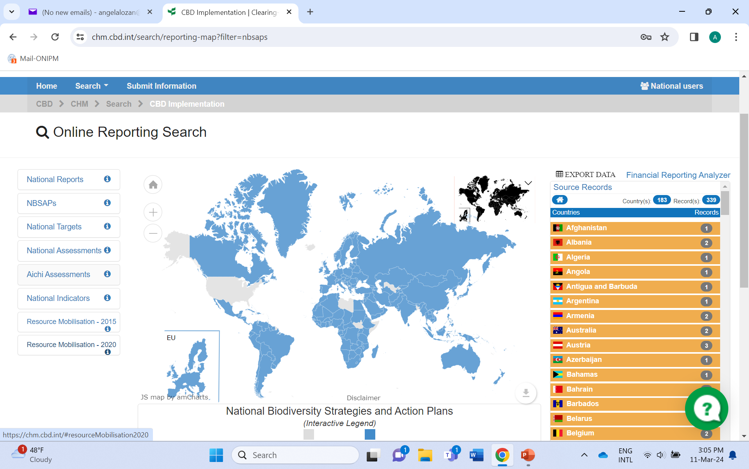
CEE and CBD statistics
NBSAP 2020 – 100% submissions
6th NR – 11 countries submission, 47.8%
4th NR Cartagena Protocol on Biosafety – 22 submissions, 100%
Interim National reports on ABS – 10 submissions, 90,9%
ABS procedures implemented just in 1 CEE country

Slide 15
CEE region nature capital
The CEE region includes a wide range of ecosystems: polar desert, tundra, forest tundra, taiga, mixed and broad-leaved forest, steppe, semi-desert and subtropical
Forests cover 850 million hectares, over 20% of the global area
The region’s 230 million hectares of croplands are vital to global food supplies
Peatlands cover 226 million hectares and represent one of the world’s largest carbon stocks
Lakes and wetlands cover 15% of the region and are connected by 120,000 rivers
The Carpathians and the Caucasus are among the most biologically rich regions on Earth
Nearly half the land in the ecoregion has already been transformed and is under severe pressure from human activities
The CEE region primarily contains upper middle-income countries, with a few lower middle- and high-income countries
The populations of CEE countries are expected to decrease significantly over the next 30 years, driven by low birth rates and outward migration

Slide 16
Quick facts CEE
One sixth of the region degraded. An estimated baseline of 269 million hectares of land in the CEE region experienced degradation in the period from 2000 to 2015, or 16.5% of the total area
While forest cover has increased across the CEE region, satellite observations indicate growing losses in recent years. Between 2000 and 2019, a total of 67 million hectares of tree cover was lost
Primary forest in some Eastern European countries is being lost at an alarming rate.
Semi-natural and natural grassland is decreasing, driven by conversion to arable land and forest
The analysis shows that, as of 2020, the total area covered by ecosystem restoration commitments in CEE countries is nearly 13.5 million hectares, equivalent to 5% of the degraded area in the region.

Slide 17
Protected Areas - Quick data
Between 2000-2019, coverage of nationally protected areas more than doubled in Republic of Moldova and Azerbaijan, increased substantially in Ukraine (75 %), and expanded to a lesser extent in Georgia (37 %), Armenia (26 %) and Belarus (17 %).
With European Union (EU) and Council of Europe support, 561 Emerald sites have been created, covering 12.3 % of the Eastern Partnership countries’ territories.
The designations used to create protected areas vary significantly across these countries due to different national legislative frameworks, making regional comparisons of the level of protection challenging.
Although countries have made substantial efforts to report data under international reporting obligations, monitoring still needs to be improved.

Slide 18
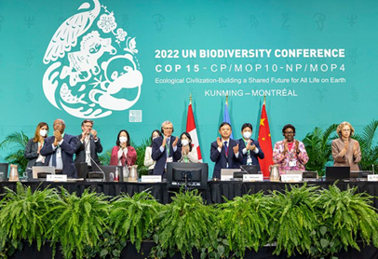
KMGBF 2030
The vision of the Kunming-Montreal Global Biodiversity Framework is a world of living in harmony with nature where “by 2050, biodiversity is valued, conserved, restored and wisely used, maintaining ecosystem services, sustaining a healthy planet and delivering benefits essential for all people.”
The mission of the Framework for the period up to 2030, towards the 2050 vision is: To take urgent action to halt and reverse biodiversity loss to put nature on a path to recovery for the benefit of people and planet by conserving and sustainably using biodiversity and by ensuring the fair and equitable sharing of benefits from the use of genetic resources, while providing the necessary means of implementation.

Slide 19
KMGBF 2030 - Reducing threats to biodiversity
loss of areas of high biodiversity importance, close to 0, by 2030
effective restoration, at least 30%, by 2030
protected areas of particular importance for biodiversity and ecosystem functions and services, are effectively conserved and managed at least to 30%, by 2030
reduce extinction of known threatened species, recovery and conservation of species
harvesting and trade of wild species is sustainable, safe and legal, preventing overexploitation
reduce and or mitigate the impacts of invasive alien species on biodiversity
reduce pollution risks and the negative impact of pollution
minimize the impact of climate change on biodiversity and increase its resilience through adaptation, ecosystem-based approaches

Slide 20
KMGBF 2030 - Meeting people’s needs through sustainable use and benefit-sharing
management and use of wild species are sustainable
areas under agriculture, aquaculture, fisheries and forestry are managed sustainably (food security)
ecosystem functions and services, ecosystem services
access to, and benefits from green and blue spaces in urban areas is sustainable
ensure the fair and equitable sharing of benefits that arise from the utilization of genetic resources and from digital sequence information on genetic resources (13)

Slide 21
KMGBF 2030 – Tools and solutions for implementation and mainstreaming
full integration of biodiversity and its multiple values into policies.
by 2030, reduce the global footprint of consumption,reducing overconsumption.
strengthen capacity for biosafety measures and measures for the handling of biotechnology and distribution of its benefits
increase resource mobilization to implement national biodiversity strategies and action plans
communication, awareness-raising, education, monitoring, research and knowledge management and, also in this context, traditional knowledge, innovations
effective and gender-responsive representation and participation and gender-responsive approach

Slide 22
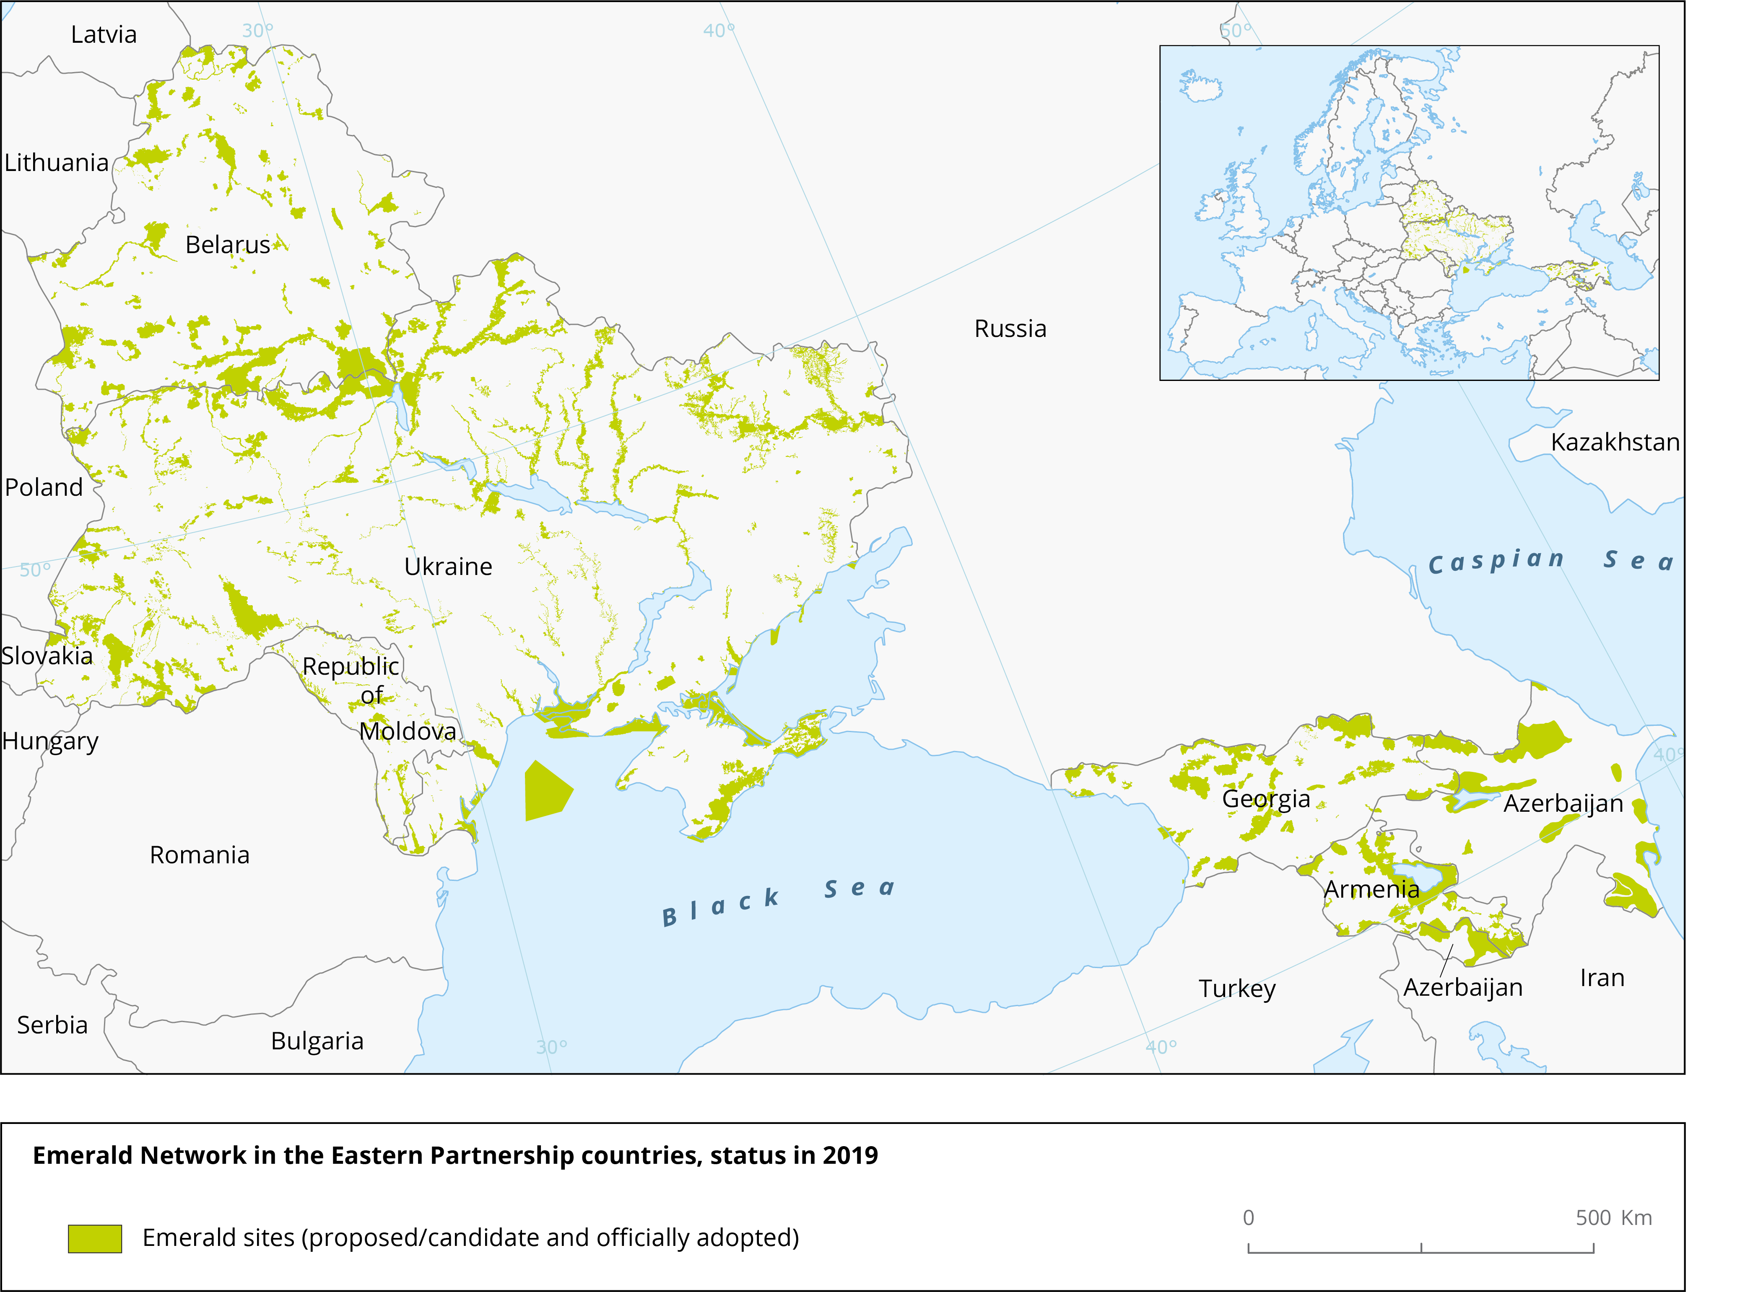
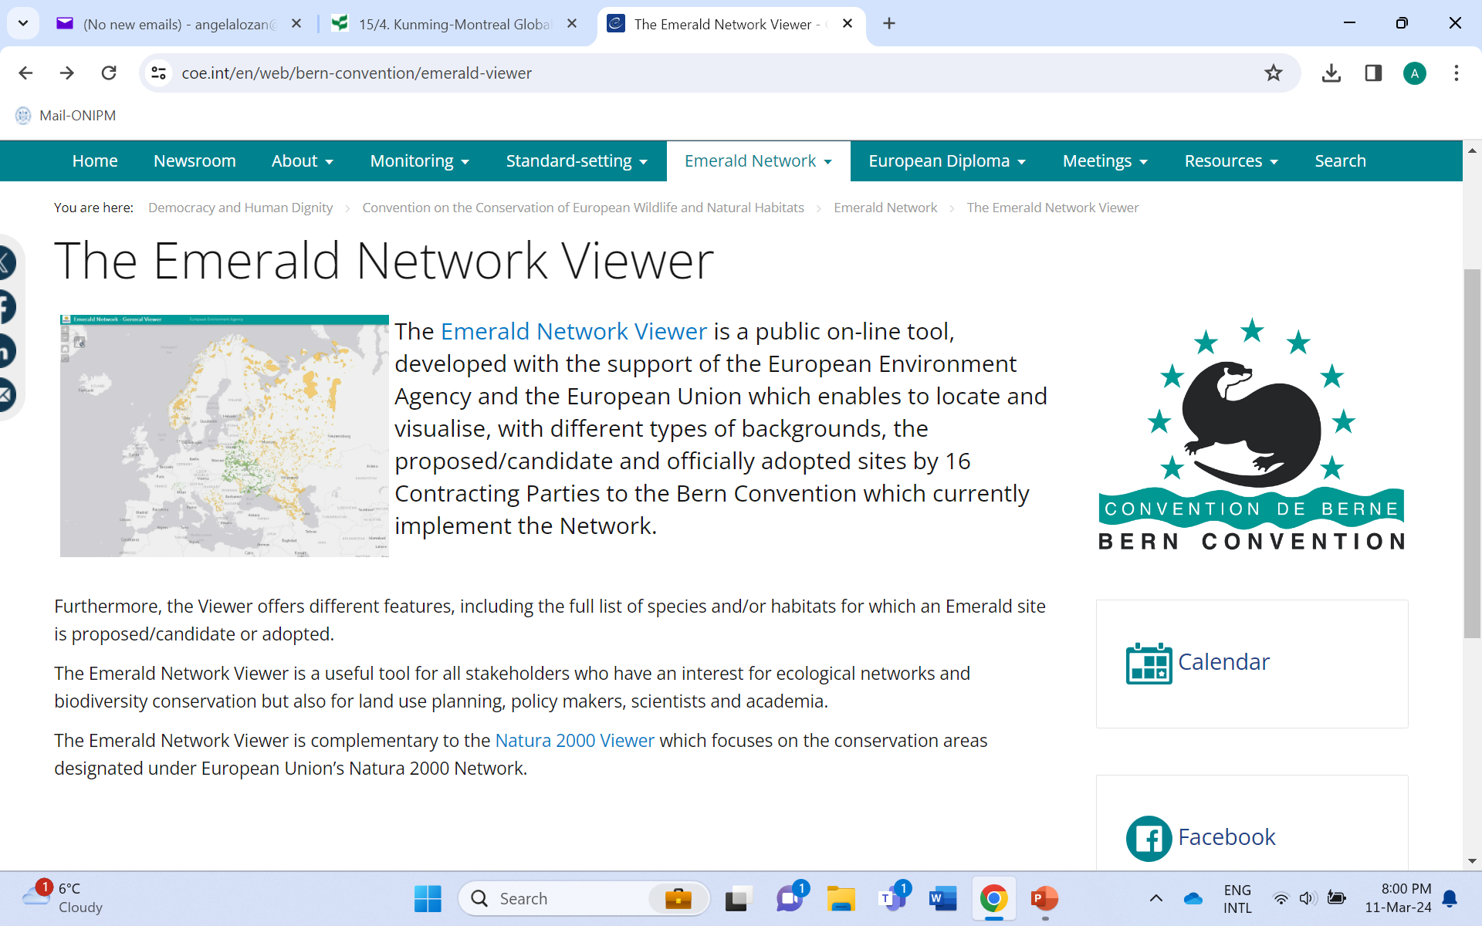
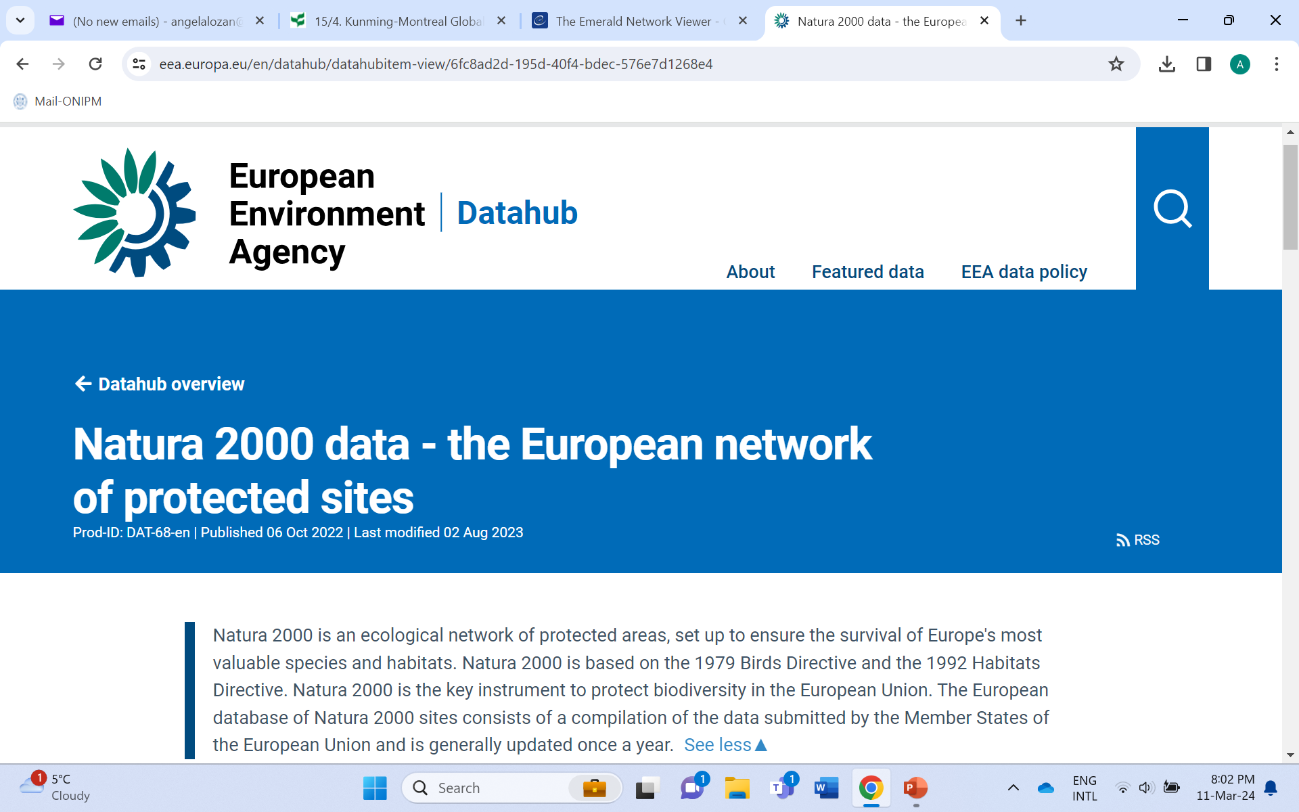
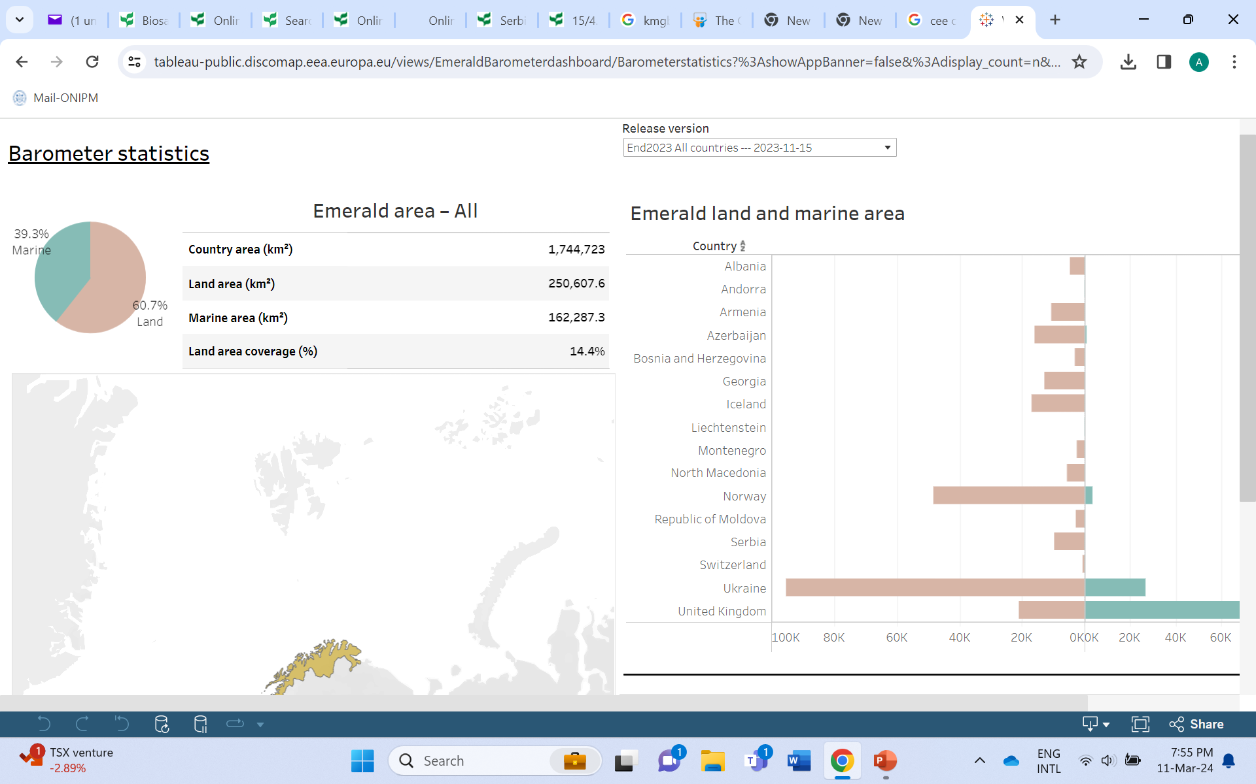
Protected areas – Natura 2000/Emerald network
Decision 15/23 Sustainable wildlife management
Decision 15/24 Conservation and sustainable use of marine and coastal biodiversity
Natura 2000 datahub
Natura 2000 viewer
Emerald Barometer
Emerald Viewer
EU Habitat and Birds Directives
Laws on wild animals, plant conservation, protected areas, Red books, forestry codes

Slide 23
Decision 15/27 Invasive alien species
Intergovernmental Science-Policy Platform on Biodiversity and Ecosystem Services in its 2019 Global Assessment Report
Invasive alien species are a major threat to nature, nature’s contributions to people, and good quality of life
Alien species are being introduced by human activities to all regions and biomes of the world at unprecedented rates. Some become invasive, causing negative and in some cases irreversible impacts on nature, including loss of uniqueness of biological communities
Policies and their implementation have been insufficient in managing biological invasions and preventing and controlling invasive alien species
Prevention and preparedness are the most cost-effective options and thus crucial for managing the threats from invasive alien species
Eradication has been successful, especially for small and slow-spreading populations of invasive alien species in isolated ecosystems
Containment and control can be an effective option
The recovery of ecosystem functions can be achieved through adaptive management, including ecosystem restoration in terrestrial and closed water systems
DRAFT METHODS FOR COST-BENEFIT AND COST-EFFECTIVENESS ANALYSIS WHICH BEST APPLY TO THE MANAGEMENT OF INVASIVE ALIEN SPECIES
Risk assessment and risk management/Multi-criteria decision-making
Capacity building needs for CEE: Policy framework/List of IAS/Early detection/ Identification (DSI)/ adaptive management, including prevention/eradication/containment and control/ecosystem restoration/public information and gender

Slide 24
Cartagena Protocol on Biosafety
Number of countries that have in place national biosafety legislation and implementing guidelines – CEE 81%
How many people in your country have been trained in risk assessment, risk management and monitoring of LMOs?Is this number adequate – 0
Decision 10/10 Risk assessment and risk management (Articles 15 and 16)
Voluntary Guidance on Risk Assessment of Living Modified Organisms (stacked genes/abiotic/trees/mosquitos/gene drives
Training Manual on Risk Assessment of Living Modified Organisms in the context of the Cartagena Protocol on Biosafety
Decision 10/11 Detection and identification of living modified organisms
Training Manual on the Detection and Identification of Living Modified Organisms
Online Network of Laboratories for the Detection and Identification of Living Modified Organisms
Decision 10/12 Socio-economic considerations (Article 26)
voluntary Guidance on the Assessment of Socio-Economic Considerations in the Context of Article 26 of the Cartagena Protocol on Biosafety
Decision 10/13 Nagoya – Kuala Lumpur Supplementary Protocol on Liability and Redress
Response measures’ as reasonable actions to prevent, minimize, contain, mitigate or otherwise avoid damage, as appropriate, or reasonable actions to restore biological diversity.

Slide 25
Digital sequence information on genetic resources (DSI)
Decision 15/9 Digital sequence information on genetic resources Decision 4/6 Digital sequence information on genetic resources
Ad Hoc Open-ended Working Group on Benefit-sharing from the Use of DSI on Genetic Resources
PROPOSED POLICY OPTIONS ON BENEFIT-SHARING FROM THE USE OF DIGITAL SEQUENCE INFORMATION ON GENETIC RESOURCES
Proposal for the establishment of a multilateral benefit-sharing mechanism

Slide 26
Decision 15/31 Synthetic biology
Broad and regular horizon scanning, monitoring and assessing of the most recent technological developments is needed for reviewing new information regarding the potential positive and potential negative impacts of synthetic biology vis-à-vis the three objectives of the Convention and those of the Cartagena Protocol on Biosafety and the Nagoya Protocol on Access and Benefit-sharing
Establishes a process for broad and regular horizon scanning, monitoring and assessment of the most recent technological developments in synthetic biology
Establishes a multidisciplinary ad hoc technical expert group on synthetic biology to support the process for broad and regular horizon scanning, monitoring and assessment

Slide 27
Access to genetic resources and benefit sharing
Only 1 country in the CEE – Belarus – reported the establishment of procedures
National Authority
Check points
MAT- COMPLIANCE WITH MUTUALLY AGREED TERMS
Registers
Internationally recognized certificates
MONETARY AND NON-MONETARY BENEFITS
Access and Benefit-sharing ClearingHouse,

Slide 28
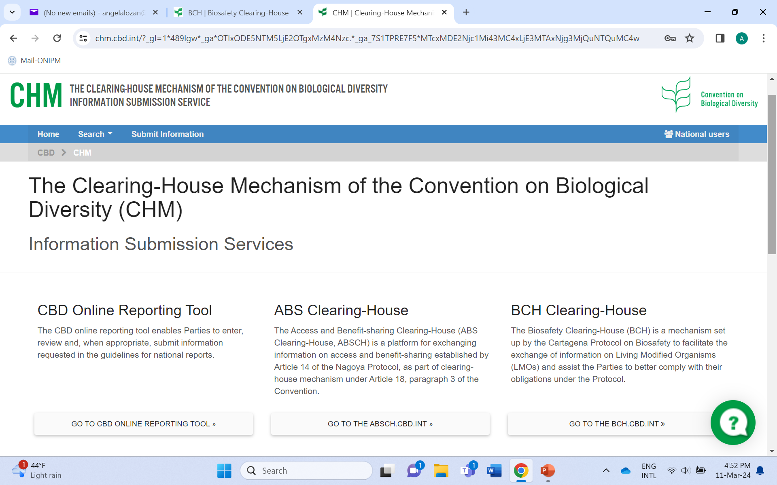
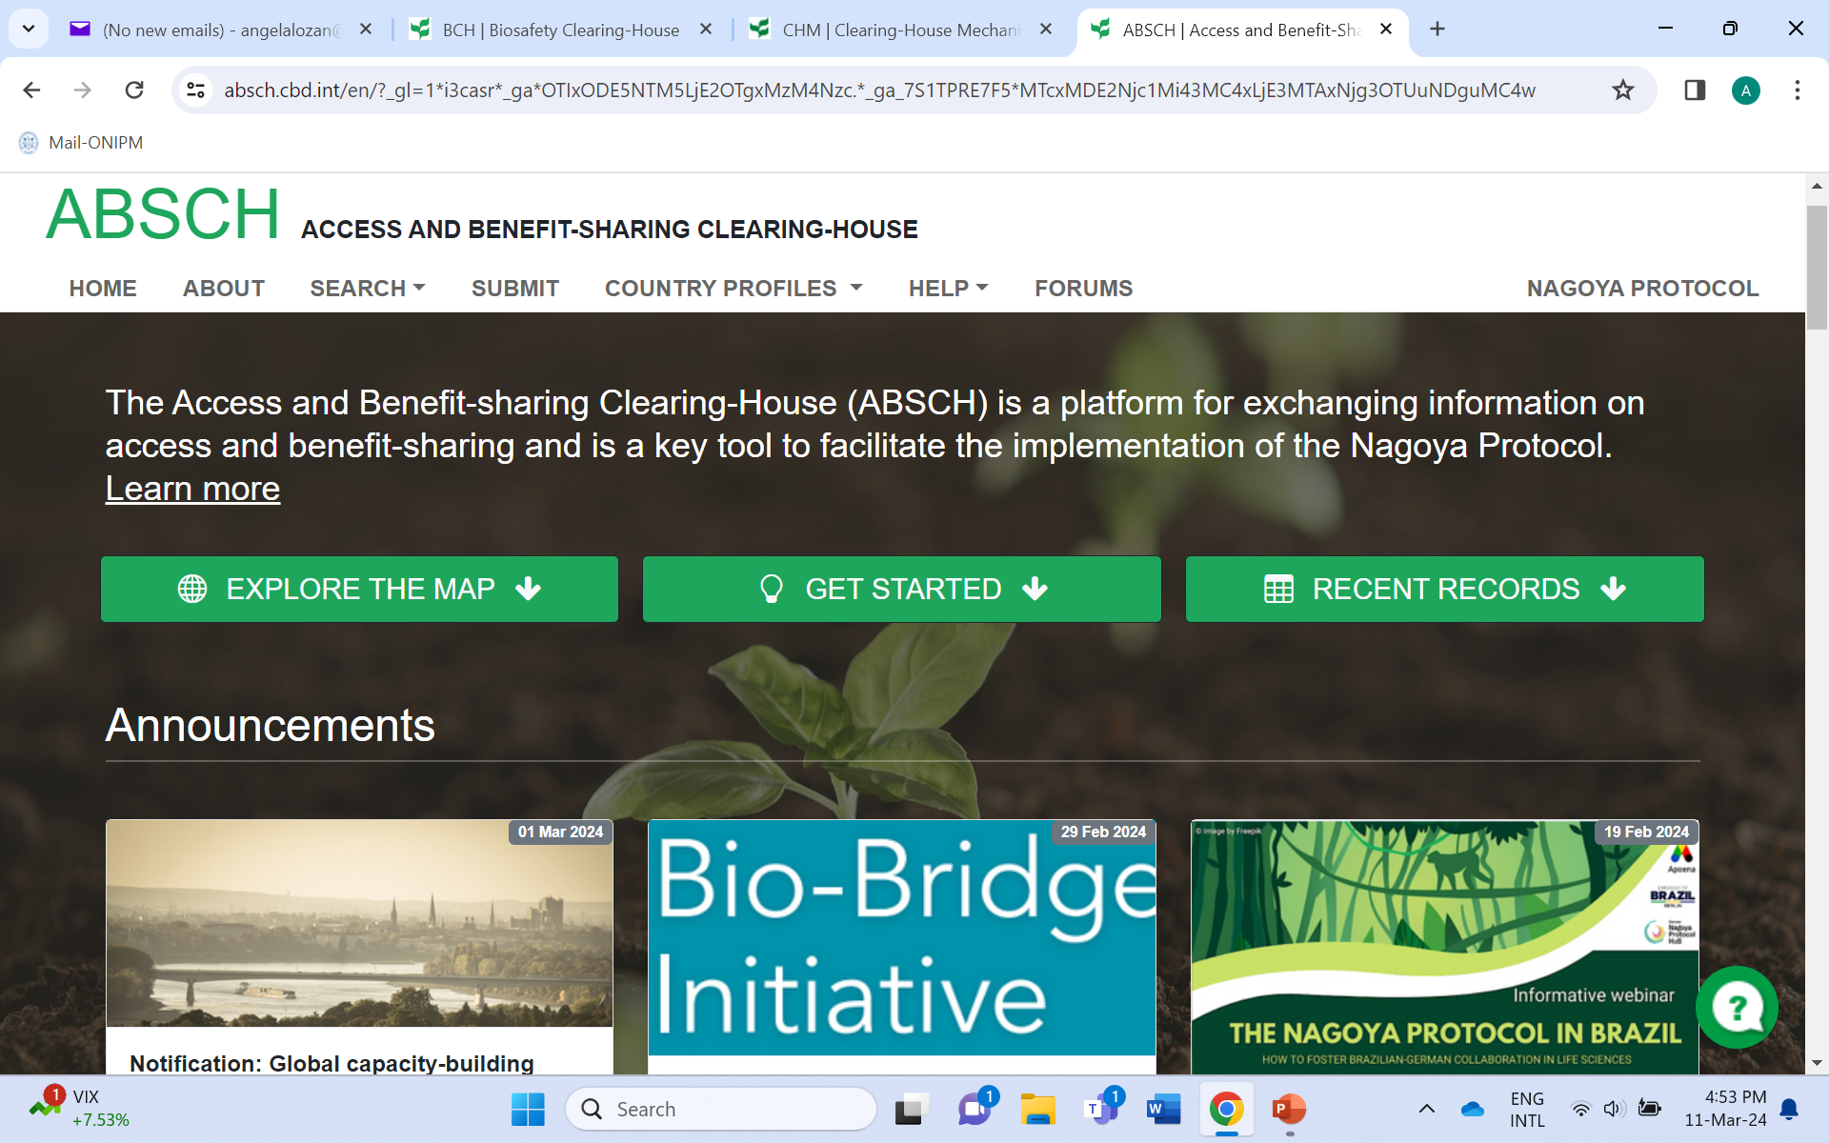
CHM, BCH, ABS CH Decision 15/16 Knowledge management and the clearing-house mechanism Decision 10/5 Operation and activities of the Biosafety Clearing-House (Article 20) Decision 4/4 Access and Benefit-sharing Clearing-House and information sharing (Article 14)

Slide 29
Capacity building
EU4ENV – Biodiversity and Emerald Network (CEE)
UNDP global ABS project (Belarus)
UNEP/GBFs Enabling activity (NBSAPs 2030) (CEE)
UNEP/ national reporting to CBD/CBP/ABS
CoE Emerald Network project (Phase I and II) (CEE)
UNEP Global NBF Biosafety implementation
Swedish CEE project Green Agenda for Armenia, Georgia, Moldova and Ukraine
WCMC project Establish Biodiversity Informational System to implement KMGBFs
BBI project CEE on DSI (Belarus), EbA (Moldova), Detection of LMOs and invasive species (Belarus)
EU Life project on Emerald Network (2024) MD_UKR
EU project Protected areas in the Eastern Partnership countries
One Health Agenda (WHO)

Slide 30
Future policy needs
The EU’s biodiversity strategy for 2030 is a comprehensive, ambitious and long-term plan to protect nature and reverse the degradation of ecosystems.
The European Green Deal was designed as the EU’s compass to achieve a clean, resource-efficient, and competitive economy goals. It aims to restoring and protecting ecosystems.
Updated NBSAPs under the KMGBF 2030
EU acquisition under EU Association or Candidate status (Ukraine, Moldova, Georgia, Armenia)
Mainstreaming Biodiversity into sectorial policies – Agriculture, Fishery, Aquaculture, Energy, Transportation, Mining, Trade, Health Care etc.

Slide 31
Available resources/reports/analyzers/links -CBD
CBD:
The 6th national reports available at: https://chm.cbd.int/database?schema_s=nationalReport6
Documents prepared for the latest COP-15 available at: https://www.cbd.int/meetings/COP-15
GBO 5 accessible here: https://www.cbd.int/gbo5
CPB:
BCH: Country Profiles page and use CEE regional filter or go to Search and select the CEE region filter.
Matrix view in the Search ,generate graphs and charts (this video explains how the Matrix works)
Report Analyzer tool (https://bch.cbd.int/en/reports) for the 4th national report.
Analysis for the latest assessment and review and final evaluation of the Strategic Plan 2011-2020
CBD/SBI/3/3 and CBD/SBI/3/3/Add.1), CBD/CP/MOP/10/INF/2).
ABS:
ABSCH: Country Profiles page and the Matrix.
Report Analyzer tool. Interim National Report of the Nagoya Protocol, all CEE countries can be filtered (https://absch.cbd.int/en/reports). Interim national reports was made available for COP-MOP-3 (including graphs) : https://www.cbd.int/doc/c/767b/a3b0/e4934613a1a3fd1116b1c89a/sbi-02-inf-03-en.pdf.
Meeting of the compliance committee
https://www.cbd.int/doc/c/b9f8/21d7/4bfb7e2798f970482a7ab776/np-cc-04-03-add1-en.pdf (all meeting
Documents are available here: https://www.cbd.int/meetings/NP-CC-04).
Capacity-building and development by region:
https://www.cbd.int/doc/c/bea3/e23e/aaa5af5559f4107ef3e130ba/np-mop-04-05-en.pdf (including graphs).

Slide 32
Angela Lozan, PhD Ministry of Environment NOIEP Bd. Stefan cel Mare 162 Chisinau Republic of Moldova email: angela.lozan@onipm.gov.md

