Slide 1
Issues regarding the provision of the Convention. Introduction to the Text and concepts at stakes.
Pierre SPIELEWOY
Muséum National d’Histoire Naturelle (France)
CO-OP4CD Central and Eastern European Countries Regional Training Session
Paris, Jardin des Plantes, 18 and 19 March 2024

Slide 2
I/ Introduction and definition of terms
1st International Convention to recognize :
Intrinsic value to nature
To use the term “biological diversity” and to define it through its different levels (including the genetic level)
To recognize the importance of indigenous knowledges
Preamble Article 1. Objectives Article 2. Use of Terms Article 3. Principle Article 4. Jurisdictional Scope Article 5. Cooperation
The CBD is a framework - the obligations set out are not very specific (unlike CITES, for example) and it leaves it up to the states to decide what needs to be implemented effectively.

Slide 3
II/ Convention objectives
A lot of debates on the terms between Conservation and SU. Finally both have been integrated.
“The objectives of this Convention, to be pursued in accordance with its relevant provisions, are the conservation of biological diversity, the sustainable use of its components and the fair and equitable sharing of the benefits arising out of the utilization of genetic resources, including by appropriate access to genetic resources and by appropriate transfer of relevant technologies, taking into account all rights over those resources and to technologies, and by appropriate funding” (Article 1)
Genetics has already been regulated (FAO), but here the dimension of fair and equitable sharing is very important and reveals the tension between the countries of the South and the North.

Slide 4
III/ Conservation of the Biological Diversity
Parties don’t really distinguish conservation and sustainable use here : both need to be integrated in national strategies
Article 6. General Measures for Conservation and Sustainable Use
Article 7. Identification and Monitoring Article 8. In-situ Conservation Article 9. Ex-situ Conservation
Article 11. Incentive Measures Article 12. Research and Training
Parties are invited to implement appropriate measures through different types of tools
Article 8 contains Article 8j on traditional knowledge, which must be protected and shared in a fair and equitable manner.

Slide 5
III/ Conservation of the Biological Diversity
“Ex-situ conservation” means the conservation of components of biological diversity outside their natural habitats.”
“In-situ conservation” means the conservation of ecosystems and natural habitats and the maintenance and recovery of viable populations of species in their natural surroundings and, in the case of domesticated or cultivated species, in the surroundings where they have developed their distinctive properties”
Article 2, use of terms
The CBD stipulates that conservation must take place both outside and inside a natural habitat/ecosystem.
Both definition cover the different levels of biological diversity (including genetics)

Slide 6
III/ Conservation of the Biological diversity
“ “Biological diversity” means the variability among living organisms from all sources including, inter alia, terrestrial, marine and other aquatic ecosystems and the ecological complexes of which they are part; this includes diversity within species, between species and of ecosystems”
Article 2, use of terms
Biological diversity or biodiversity? For the purposes of the Convention, biological diversity is used, even though the concept of biodiversity already existed at the time. Biological diversity is more precise - we can see here the different levels it implies. “Biodiversity” is a concept close to "Nature" = we do not know exactly what it implies...

Slide 7
III/ Conservation of the Biological diversity
Some COP decisions on this topic
Conservation and sustainable use of marine and coastal biological diversity : DEC II/10, IV/5
Conservation and sustainable use of agricultural biological diversity : DEC III/11
Programmes of Work : on marine biodiversity, forest, arid lands, wetlands, agriculture, plants, pollinators..
Protected areas : DEC VII/28, VIII/24, IX/18, X/31, XI/24, XIV/8
What is at stake? Conservation must always be considered alongside national sovereignty and the needs of certain activities for biodiversity resources...
At what extent is conservation possible ? On what type of biological diversity ? How to organize conservation ?

Slide 8
IV/ Sustainable Use of its component
Article 6. General Measures for Conservation and Sustainable Use
Article 10. Sustainable Use of Components of Biological Diversity Article 14. Impact Assessment and Minimizing Adverse Impacts
Sustainability is (in 1992) the core concept of the environmental governance.
When reading this article, we could see the constant interaction between sustainable use and conservation.
Sustainability means also to respect customary use of biological resources (Article 10, (c); in that regard, sustainability is a constant socio-ecological negotiation.

Slide 9
IV/ Sustainable Use of its component
“Sustainable use” means the use of components of biological diversity in a way and at a rate that does not lead to the long-term decline of biological diversity, thereby maintaining its potential to meet the needs and aspirations of present and future generations.
Article 2, use of terms
Two dimensions in this definition of the use of biological diversity :
It should not cause any significant cause in the resource
It should not harm any other component of biodiversity
So, here’s a very precise one.

Slide 10
IV/ Sustainable Use of its component
Some COP decisions on this topic
Conservation and sustainable use of marine and coastal biological diversity : DEC II/10, IV/5
Conservation and sustainable use of agricultural biological diversity : DEC III/11
Sustainable use of bushmeat… XI/25 etc…
Sustainable use as a cross-cutting issue : DEC V/24
Recognizing also that conservation and sustainable use of biological diversity is essential to the survival of species and also benefits humankind particularly those people who are dependent on biological resources for their livelihoods,
Further recognizing the importance of integrating, as far as possible and as appropriate, the conservation and sustainable use of biological diversity into sectoral or cross-sectoral plans, programmes and policies, and recognizing the importance of addressing this issue in national biodiversity strategies and action plans, in accordance with Articles 6 and 10 of the Convention on Biological Diversity,
Taking into account the decisions of the Conference of the Parties and the ecosystem approach,
Noting the synergies between the conservation and sustainable use of biological diversity,
Noting also that the highest levels of biodiversity often occur in the less economically developed regions,

Slide 11
IV/ Sustainable Use of its component
Some COP decisions on this topic
Conservation and sustainable use of marine and coastal biological diversity : DEC II/10, IV/5
Conservation and sustainable use of agricultural biological diversity : DEC III/11
Sustainable use of bushmeat… XI/25 etc…
Sustainable use as a cross-cutting issue : DEC V/24
What is at stake? Sustainable use is included in the Convention as a reminder of the importance of biological diversity for national economies. It is an important element in the potential development of certain countries.
Where do you draw the line between protection and use? What could be used, what could be not ?

Slide 12
V/ Fair and equitable sharing of the benefits arising out the utilization of genetic resources
Until the CBD, the principle of free access to genetic resources prevailed (FAO Undertaking on Plant Genetic Resources of 1983).
Article 15. Access to Genetic Resources
Article 16. Access to and Transfer of technology
Article 17. Exchange of Information Article 18. Technical and Scientific Cooperation
Article 19. Handling of Biotechnology and Distribution of its Benefits
The question of biotechnology is deeply linked with the access to genetic resources.

Slide 13
V/ Fair and equitable sharing of the benefits arising out the utilization of genetic resources – Genetic Resources
“"Genetic material" means any material of plant, animal, microbial or other origin containing functional units of heredity.”
“"Genetic resources" means genetic material of actual or potential value.”
“Country of origin of genetic resources” means the country which possesses those genetic resources
in in-situ conditions.
“Country providing genetic resources” means the country supplying genetic resources collected from in-situ sources, including populations of both wild and domesticated species, or taken from ex-situ sources, which may or may not have originated in that country”
Article 2 use of terms
The Convention's obligation only applies to genetic resources. This raises the question of demonstrating actual or potential value.
Genetic resources collected in gene banks for example, are excluded a priori

Slide 14
V/ Fair and equitable sharing of the benefits arising out the utilization of genetic resources – Genetic Resources
Some COP Decisions on this topic
Access to genetic resources : II/11, III/15, V/26
Access and Benefit sharing as related to the genetic resources : VI/24, VII/19, X/1 Digital Sequence information on genetic resources : XIII/16, etc…
X/1, Parties Decided to adopt the Nagoya Protocol on Access to Genetic Resources and the Fair and Equitable Sharing of Benefits Arising from their Utilization to the Convention on Biological Diversity (the Protocol)
V/26, Parties decided to establish an Ad Hoc Open-ended Working Group, to develop guidelines and other approaches for submission to the Conference of the Parties and to assist Parties and stakeholders in addressing the elements as relevant to access to genetic resources and benefit-sharing
XIII/16, Parties noted that digital sequence information on genetic resources is a cross-cutting issue that may concern the three objectives of the Convention on Biological Diversity

Slide 15
V/ Fair and equitable sharing of the benefits arising out the utilization of genetic resources – Genetic Resources
Some COP Decisions on this topic
Access to genetic resources : II/11, III/15, V/26
Access and Benefit sharing as related to the genetic resources : VI/24, VII/19, X/1 Digital Sequence information on genetic resources : XIII/16, etc…
What is at stake? Access to Genetic resources needs to be carefully defined.
What does this have to do with property rights? Freedom of research? And what exactly is meant by "genetic resources"?

Slide 16
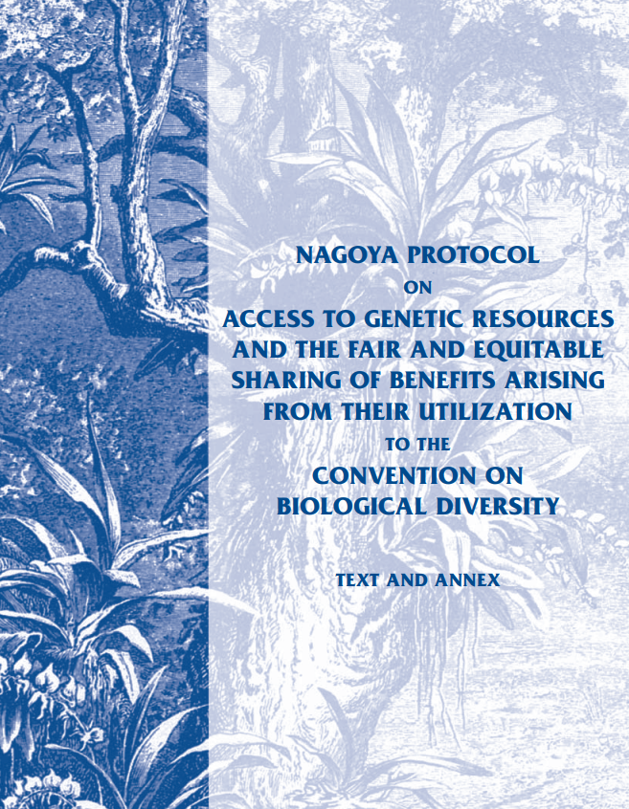
V/ Fair and equitable sharing of the benefits arising out the utilization of genetic resources
Nagoya Protocol
“The Nagoya Protocol on Access to Genetic Resources and the Fair and Equitable Sharing of Benefits Arising from their Utilization to the Convention on Biological Diversity is an international agreement which aims at sharing the benefits arising from the utilization of genetic resources in a fair and equitable way. It entered into force on 12 October 2014, 90 days after the date of deposit of the fiftieth instrument of ratification.”
(CBD Website)

Slide 17
V/ Fair and equitable sharing arising out the utilization of genetic resources – Biotechnology
“ 'Biotechnology'' means any technological application that uses biological systems, living organisms, or derivatives thereof, to make or modify products or processes for specific use”
“Technology” includes biotechnology.
Article 2, use of terms
Very broad definition of biotechnology.
On reading Article 19, we understand that the obligation of access to biotechnology includes biotechnological research, but also that any risk generated by the manipulation of biotechnology must be anticipated and managed.

Slide 18
V/ Fair and equitable sharing of the benefits arising out the utilization of genetic resources – Biotechnology
Some COP Decisions on this topic
Consideration of the need and modalities of a protocol for a safe transfer, handling and use of living modified organisms : II/5
Transfer and development of Technology : II/4, III/16, …etc… sometimes also considered within the question of the technical and scientific cooperation (article 18).
The protocol will be adopted 4 years later at Cartagena
Article 19, par. 3 also mentioned the need to consider the adoption of a protocol.

Slide 19
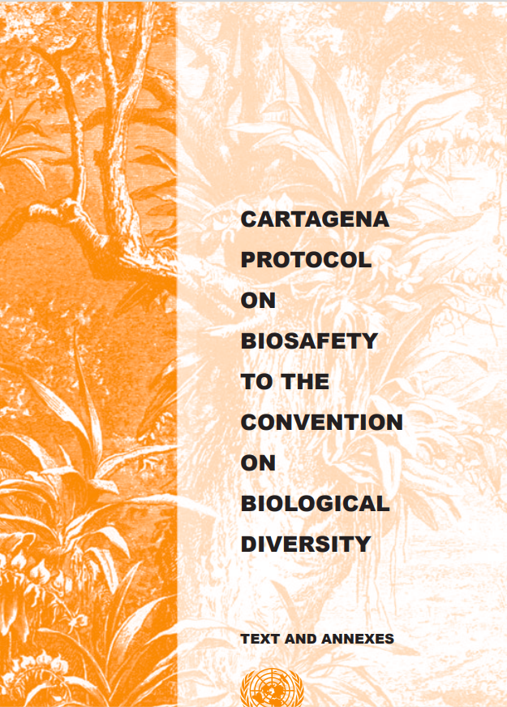
V/ Fair and equitable sharing of the benefits arising out the utilization of genetic resources - Biotechnology
Cartagena Protocol
The Cartagena Protocol on Biosafety to the Convention on Biological Diversity is an international agreement which aims to ensure the safe handling, transport and use of living modified organisms (LMOs) resulting from modern biotechnology that may have adverse effects on biological diversity, taking also into account risks to human health. It was adopted on 29 January 2000 and entered into force on 11 September 2003.
(CBD Website)

Slide 20
VI/ Informing Biological Diversity
Article 12. Research and Training
Article 13. Public Education and Awareness
Article 17. Exchange of Information Article 18. Technical and Scientific Cooperation
A special role for Science and scientists
Research
Capacity Building
Technology Transfer

Slide 21
VI/ Informing Biological Diversity
Aware of the general lack of information and knowledge regarding biological diversity and of the urgent need to develop scientific, technical and institutional capacities to provide the basic understanding upon which to plan and implement appropriate measures, (Pr. §7)
Noting also that where there is a threat of significant reduction or loss of biological diversity, lack of full scientific certainty should not be used as a reason for postponing measures to avoid or minimize such a threat (Pr. §9)
Recognizing the close and traditional dependence of many indigenous and local communities embodying traditional lifestyles on biological resources, and the desirability of sharing equitably benefits arising from the use of traditional knowledge, innovations and practices relevant to the conservation of biological diversity and the sustainable use of its components (Pr. §12)
Aware of the general lack of information and knowledge regarding biological diversity and of the urgent need to develop scientific, technical and institutional capacities to provide the basic understanding upon which to plan and implement appropriate measures, (Pr. §7)

Slide 22
VI/ Informing Biological Diversity
Article 12. Research and Training
The Contracting Parties, taking into account the special needs of developing countries, shall:
(a) Establish and maintain programmes for scientific and technical education and training in measures for the identification, conservation and sustainable use of biological diversity and its components and provide support for such education and training for the specific needs of developing countries;
(b) Promote and encourage research which contributes to the conservation and sustainable use of biological diversity, particularly in developing countries, inter alia, in accordance with decisions of the Conference of the Parties taken in consequence of recommendations of the Subsidiary Body on Scientific, Technical and Technological Advice; and
c) In keeping with the provisions of Articles 16, 18 and 20, promote and cooperate in the use of scientific advances in biological diversity research in developing methods for conservation and sustainable use of biological resources.

Slide 23
VI/ Informing Biological Diversity
Article 18. Technical and Scientific Cooperation
1. The Contracting Parties shall promote international technical and scientific cooperation in the field of conservation and sustainable use of biological diversity, where necessary, through the appropriate international and national institutions.
2. Each Contracting Party shall promote technical and scientific cooperation with other Contracting Parties, in particular developing countries, in implementing this Convention, inter alia, through the development and implementation of national policies. In promoting such cooperation, special attention should be given to the development and strengthening of national capabilities, by means of human resources development and institution building.
3. The Conference of the Parties, at its first meeting, shall determine how to establish a clearing-house mechanism to promote and facilitate technical and scientific cooperation.
4. The Contracting Parties shall, in accordance with national legislation and policies, encourage and develop methods of cooperation for the development and use of technologies, including indigenous and traditional technologies, in pursuance of the objectives of this Convention. For this purpose, the Contracting Parties shall also promote cooperation in the training of personnel and exchange of experts.
5. The Contracting Parties shall, subject to mutual agreement, promote the establishment of joint research programmes and joint ventures for the development of technologies relevant to the objectives of this Convention.

Slide 24
VII/ Mechanisms and Processes
Article 23. Conference of the Parties Article 24. Secretariat Article 25. Subsidiary Body on Scientific, Technical and Technological Advice Article 26. Reports Article 31. Right to Vote
Article 40. Secretariat Interim Arrangements
The SBSTTA is the only subsidiary body created by the Treaty

Slide 25
VIII/ Life of the Convention
Article 20. Financial Resources Article 21. Financial Mechanism
Article 22. Relationship with Other International Conventions Article 27. Settlement of Disputes Article 28. Adoption of Protocols Article 29. Amendment of the Convention or Protocol Article 30. Adoption and Amendment of Annexes Article 31. Right to Vote
Article 32. Relationship between this Convention and Its Protocols
Article 39. Financial Interim Arrangements Article 40. Secretariat Interim Arrangements
The CBD is not the first convention to deal with the conservation of elements of biological diversity, but it is the first framework.
A disclaimer is added here, concerning marine resources that must be taken into account under the Law of the Sea (UNCLOS).

Slide 26
IX/ Entry into force / legal implementation
Article 33. Signature Article 34. Ratification, Acceptance or Approval Article 35. Accession Article 36. Entry Into Force Article 37. Reservations Article 38. Withdrawals
Article 41. Depositary Article 42. Authentic texts
The CBD entered into force on 29 December 1993. There are 196 parties to the Convention

Slide 27
Thank you for your attention!
Pierre Spielewoy
pierre.spielewoy@mnhn.fr
www.coop4cbd.eu
Follow COOP4CBD

