Slide 1
CBD Decision-making process from internal to external point of view and vice-versa
Didier Babin
CIRAD / MAB-France
Capacity Building Workshop for Hungarian, Romanian and Polish
experts and negotiators / 15-16 January 2024 / Budapest, Hungary

Slide 2
A short survey …

Slide 7
The CBD “negotiation” in a few words
Emergence
Links with the « D » of UNCED
Conceptualization (80’s by IUCN)
Preparation (late 80’s by UNEP) AHGEBD
Pre-negotiation (early 90’s) in “rush” / UNEP Nairobi
Negotiation also in haste (May 22, 1992) / UNCED
? Host institution
Biodiversity essential for sustainable development
Biodiversity in its socio-economic context
Takes into account biotechnologies (new and emerging)
And the question of financial and technological transfers to the owners of biological resources

Slide 8
CBD: First convention on sustainable development
Recognition of the social, economic and political dimensions and values of biodiversity
Framework agreement based on 3 principles:
National implementation,
Coordination with other agreements,
Post-framework negotiation of annexes, binding protocols and non-binding work programs
The 3 objectives
Conservation of biological diversity
Sustainable use
Fair and equitable sharing of benefits arising from the use of genetic resources

Slide 9
Scope of the CBD
From the protection of ecosystems to genetic resources,
From conservation to justice,
From commerce to scientific knowledge,
From the attribution of rights to the recognition of responsibilities
New questions in the field of nature protection such as intellectual property rights, community rights, etc.

Slide 12
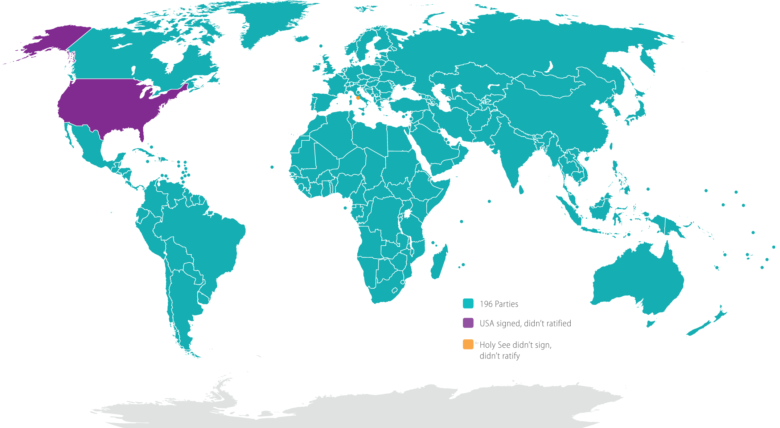

Slide 14
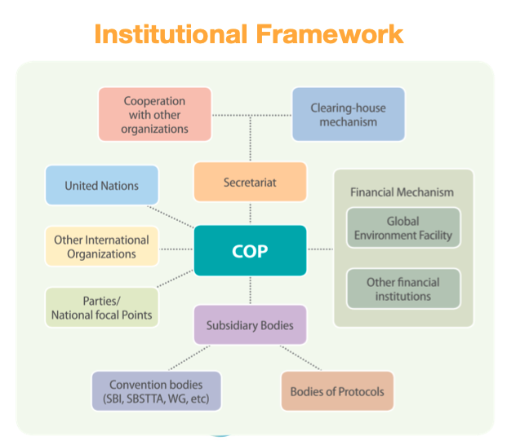

Slide 15
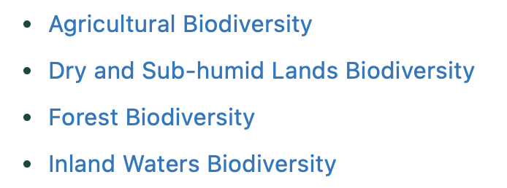
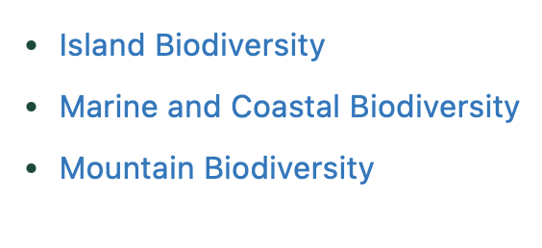
7 programmes of works

Slide 16
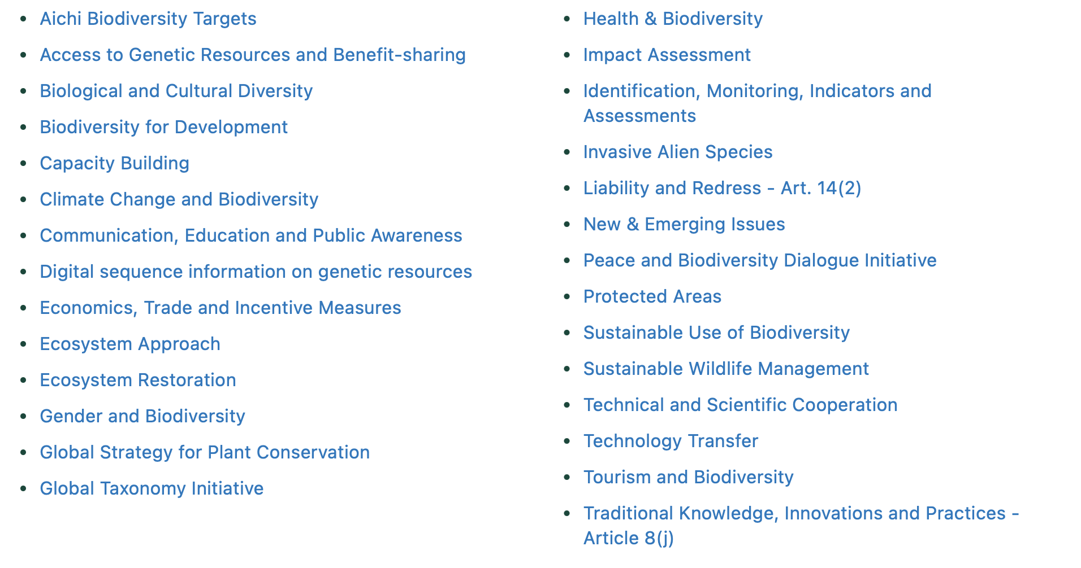
And cross-cutting issues

Slide 17
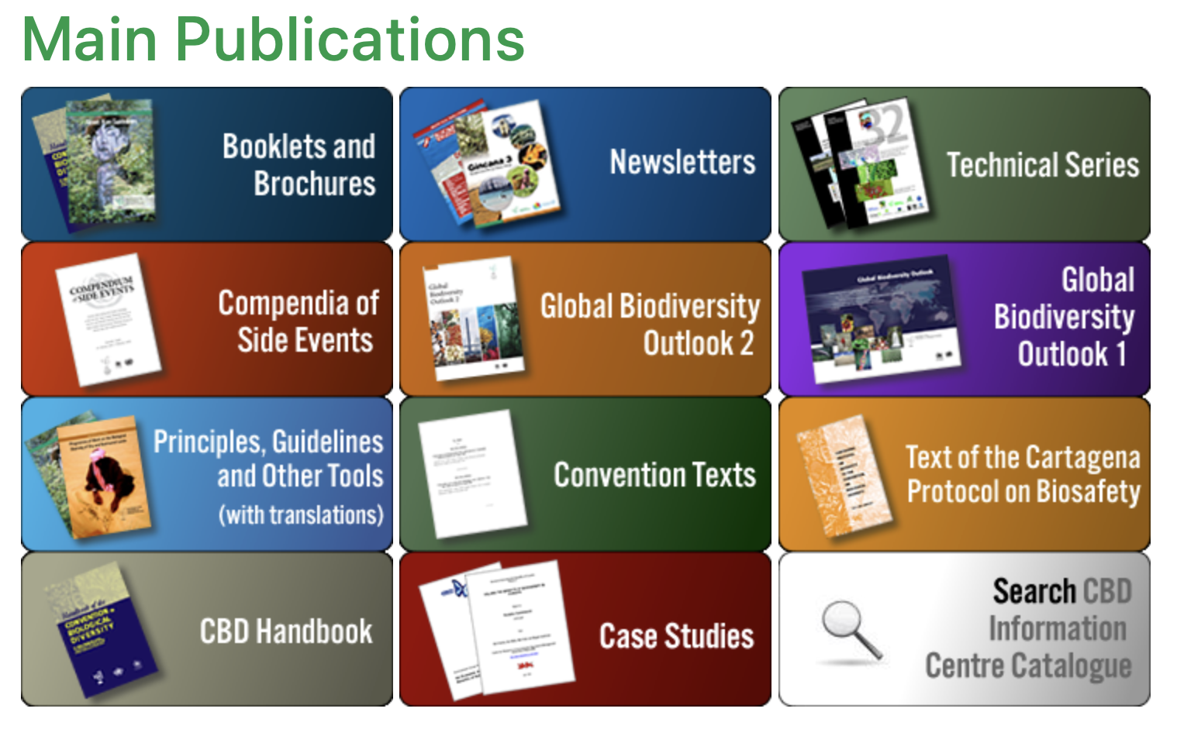

Slide 18
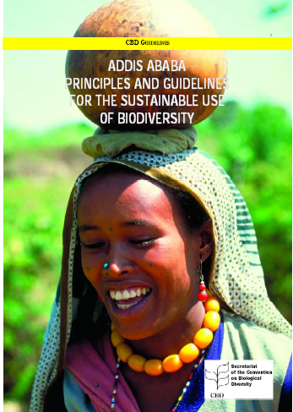
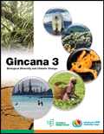

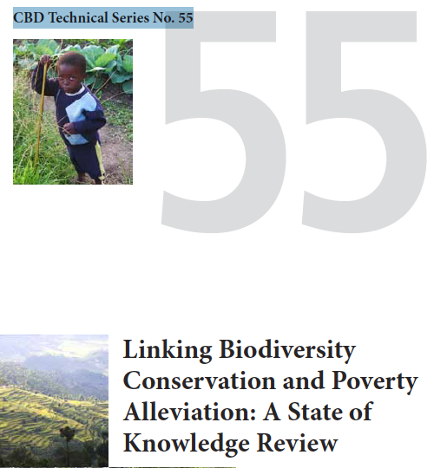
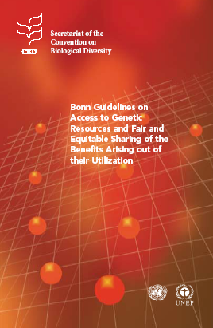


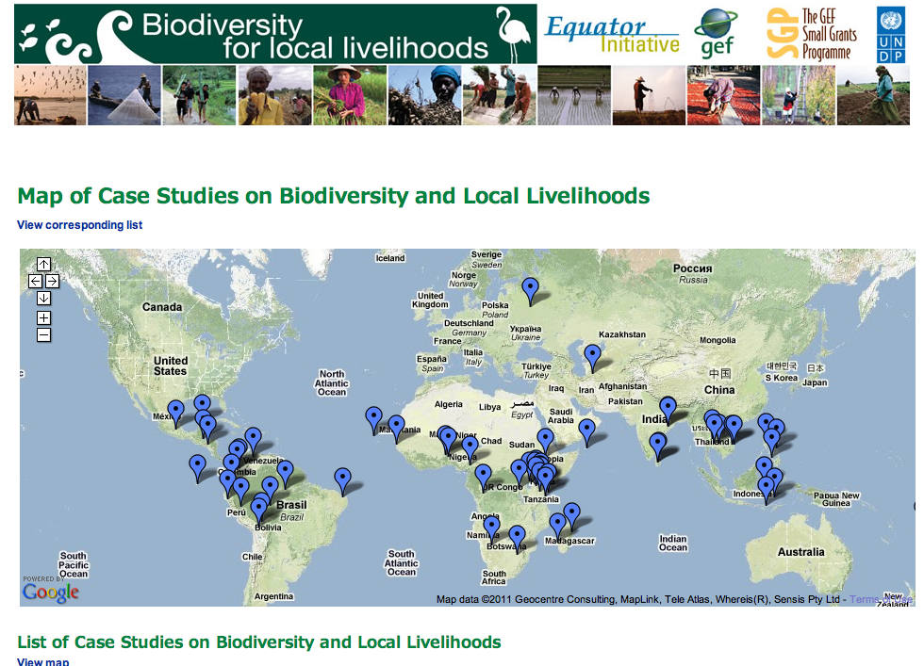
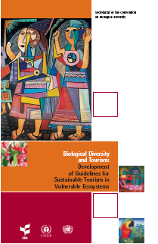
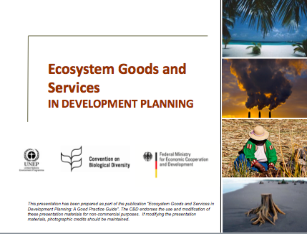

Slide 19
Global Agreements and Regimes Relevant to the Scope of the CBD (updated from D. M. McGraw, 2002)
Scope : | Environment Economy /Trade
Goals Periods | Conservation | Sustainable Use | Access Benefit Sharing | Others
1970-1990 | CITES CMS Ramsar WHC UNCLOS | CITES Int.Tropic. Timber Ag. | Intern. Undertaking on Plant Gen Res UNCLOS (deep Seabed Mining) | Vienna Convention and Montreal Protocol Basel Convention Convention on transboundary air pollution
1990-2000 | CBD UNCLOS (Fish stocks) Int. Coral Reef Init. | CBD UNFCCC UNCCD UNCLOS (Fish Stocks) ICRI | CBD Intern. Plant Protec Conservation revised | WTO TRIPS Basel Protocol Kyoto Protocol
2000 and after | Potential CBD protocol (?) | Potential CBD protocol (?) | Intern. Treaty on PGR for Food & Ag. Nagoya Protocol (2014) | Cartagena Protocol on Biosafety (2003) Rotterdam Convention Stockholm Convention Nagoya-Kuala Lumpur Supplementary Protocol on Liability and Redress (2018)

Slide 20
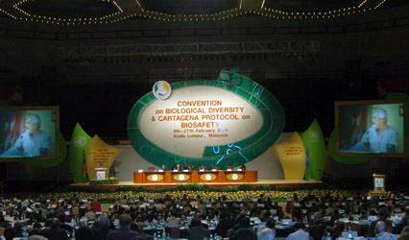
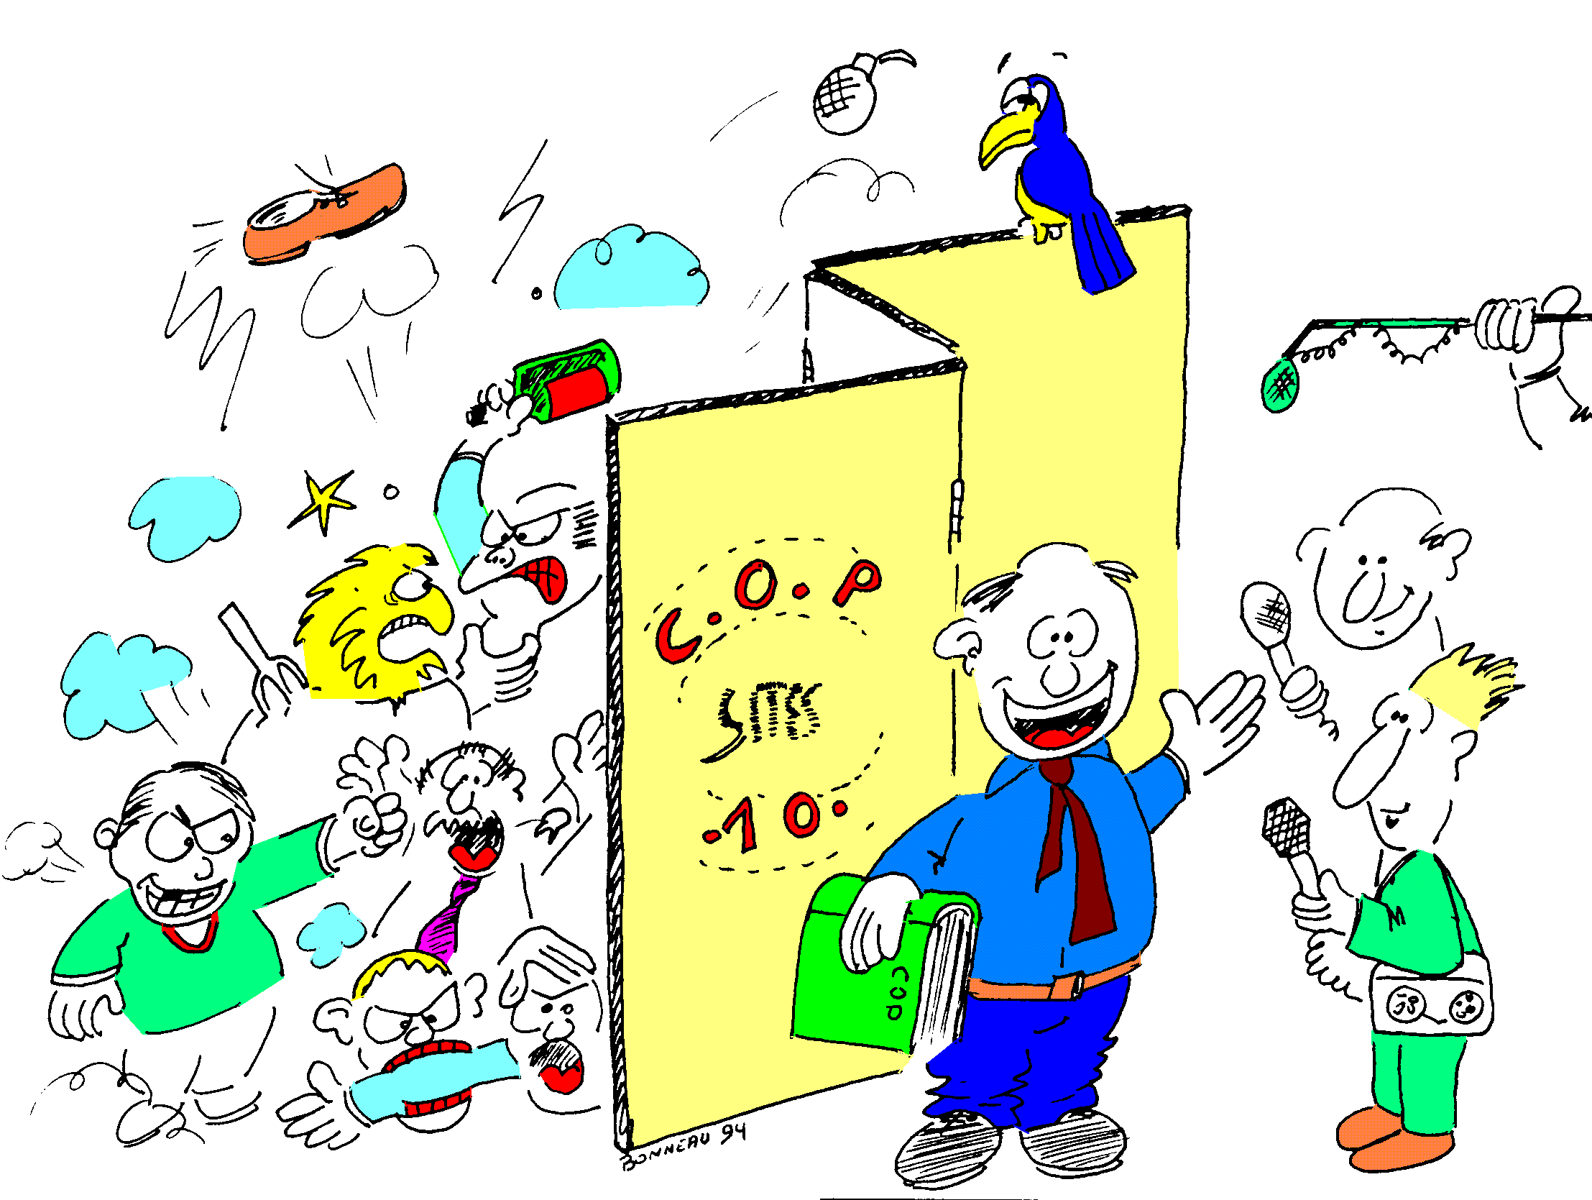

Conference of the Parties
– COP
brings together all Parties
one part = one voice
adopts decisions (including work programs)
and the budget

Slide 21
COP Parties and Stakeholders (Influencers)
“Parties” and “Non-Parties”
IPLCs
NGOs
Education
Academics and Science
Business and Industry
The UN system
The media
More recent ones:
Cities
Subnational governments
Regional economic integration organizations
Regional development banks

Slide 22
COP Parties and Stakeholders
Diplomatical
Political
The UN regions (WEOG (EU-JUSCANZ), AFR, CEE, GRULAC, AP) between them
“Parties” vs. “non-Parties”
Northern vs. Southern Countries *
Megadiverse countries vs the “poor” in Biodiv
G77 (+/- China) vs G7/8
BRICS vs. the rest of the planet
ALBA vs the rest of the planet
Small Island Developing States (SIDS)
Ministry against other Ministry
Science vs diplomacy
NGOs vs « Parties »
IPLCs vs Countries
Cities & Local Authorities vs Parties
Women vs Men
CBD vs UN system
…

Slide 23
COP Parties and Stakeholders
Biodiversity family
Behind the Scene
The need for consensus
Non-binding decisions
Beyond diplomacy:
  Transfers - defectors
  Influence networks
  The individual and collective interest of a strong Convention
Side events
Parallel Summits
IPLCs, Youth, CLA, Business, Faith, …
Stands - booths
Scientific symposium
Protests, Medias, …
etc

Slide 24
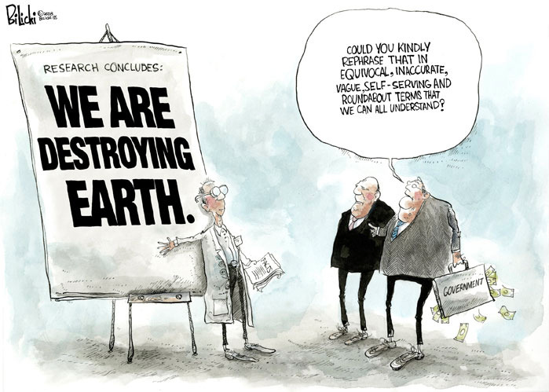


Slide 25
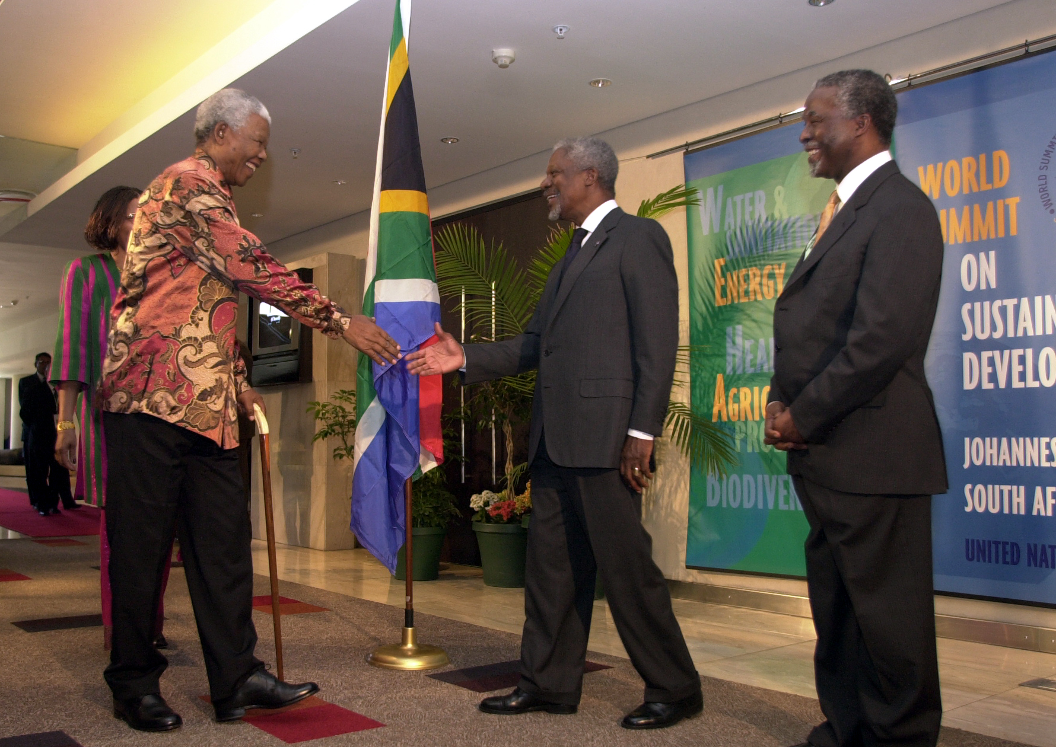
I try to stay optimistic !
COP 6 - 2002 Strategic Plan for 2010
“significantly reduce the rate of biodiversity loss by 2010”, taken up by the Johannesburg Summit (and in the MDG 7-2)
National strategy (NBSAP) and implementation via Sectoral integration
European Union objective : Zero Biodiversity Loss by 2010 !

Slide 26
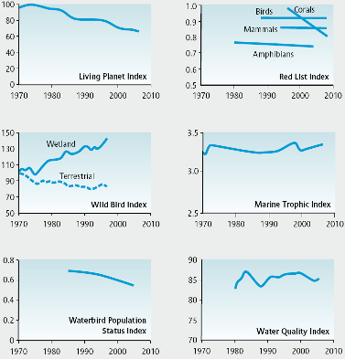
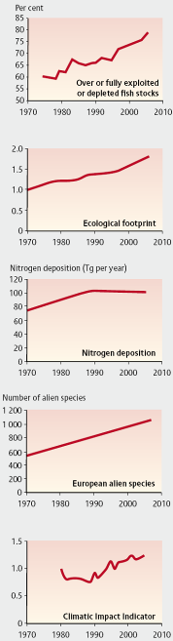
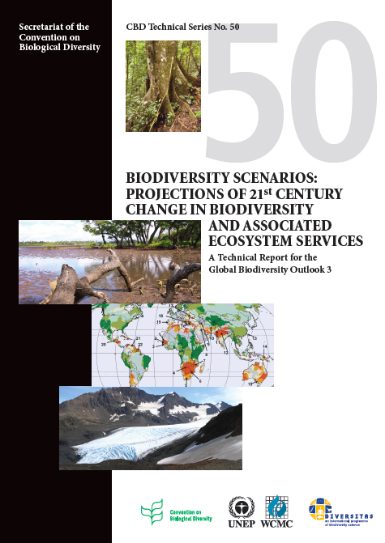
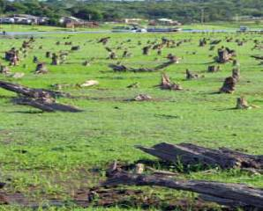

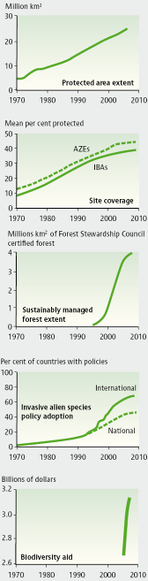
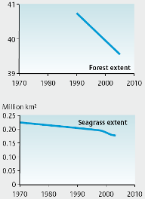
Etats
Pressions
Tiping points!

Slide 27

I try to stay optimistic !
COP 10 - 2010 Aichi Biodiversity Targets for 2020
47 decisions from COP-10, including:
The Nagoya Protocol on ABS
The Aichi Strategic Plan and Targets
Strategy for Resource Mobilization
17 MOP decisions, including:
The Nagoya-KL Protocol on Liability and Redress
The Strategic Plan for the Biosafety Protocol
Plus declarations from parallel meetings on local authorities, cities, parliamentarians, biodiversity and development

Slide 28
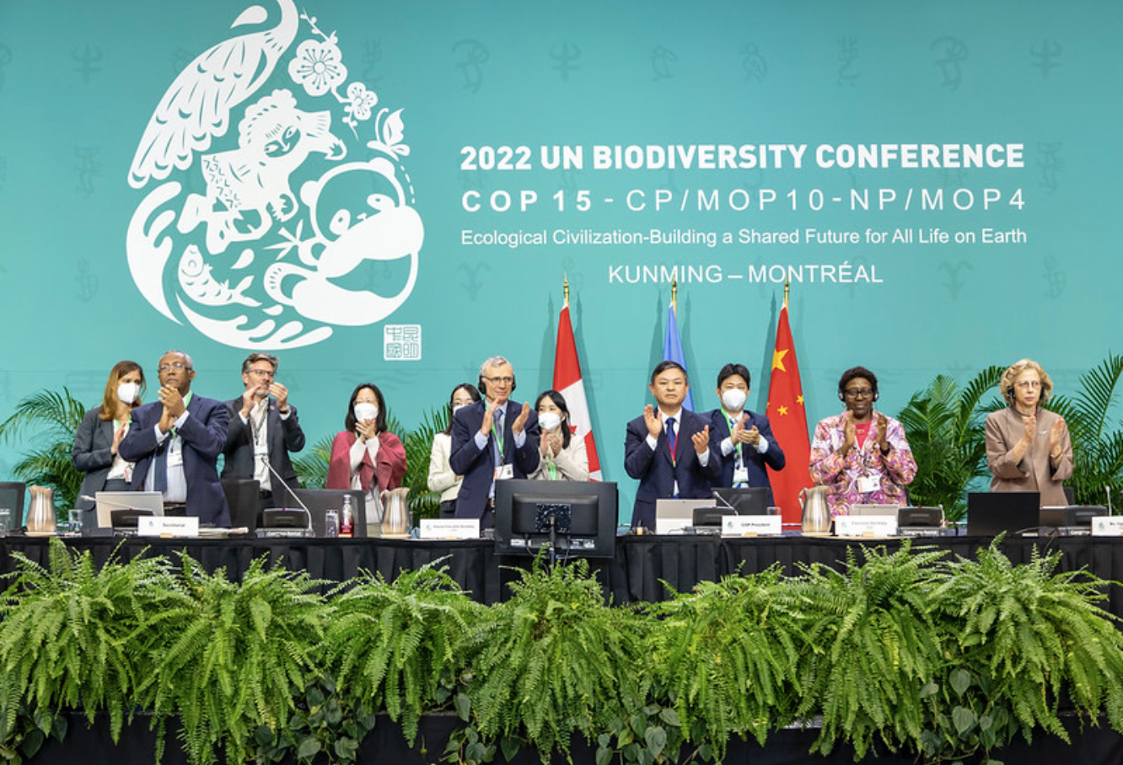
I try to stay optimistic !
COP 15 – KM GFB for 2030
A historical package of measures deemed critical to addressing the dangerous loss of biodiversity and restoring natural ecosystems
Nations adopt four Goals, 23 targets for 2030 in Landmark UN Biodiversity Agreement
By 2030: protect 30% of Earth’s lands, oceans, coastal areas, inland waters; reduce by $500 billion annual harmful government subsidies, Cut food waste in half, … and more

Slide 29
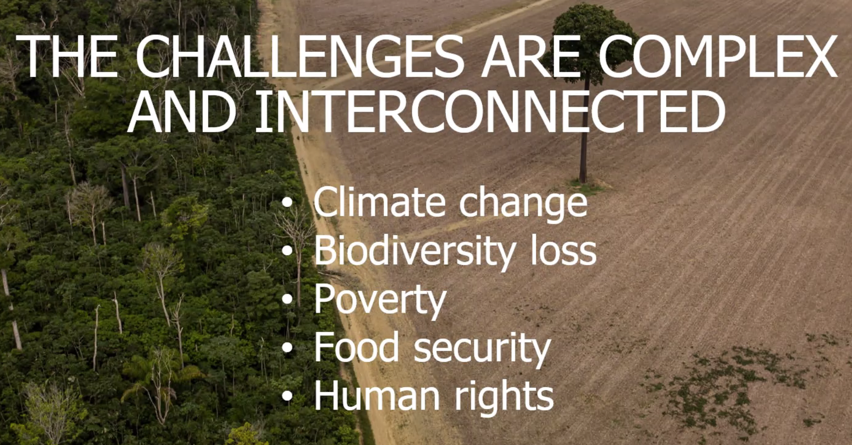
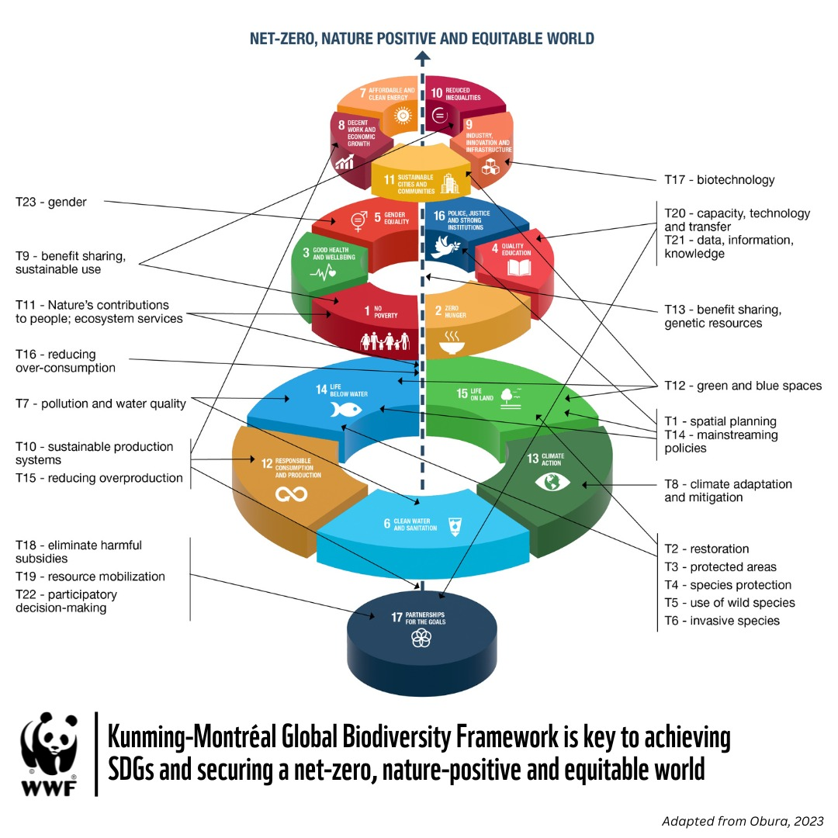
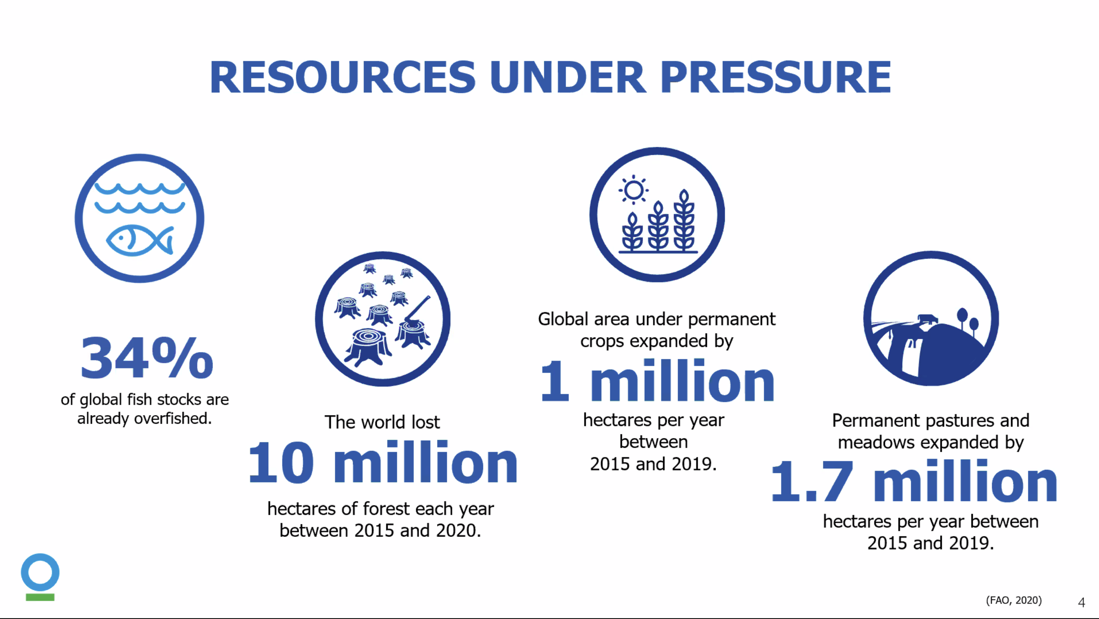

Slide 30
CBD Meetings in 2023 (with official nomination)
Eleventh meeting of the Inter-agency Liaison Group on Invasive Alien Species (5 April)
First meeting of the Ad Hoc Technical Expert Group on Indicators for the Kunming-Montreal Global Biodiversity Framework (2 May)
Twelfth meeting of the Informal Advisory Committee on the Biosafety Clearing-House (15-16 May)
First meeting of the Informal Advisory Group on Technical and Scientific Cooperation (14-16 June)
Informal Advisory Committee on Capacity-building for the Implementation of the Nagoya Protocol (20-22 June)
First meeting of the multidisciplinary Ad Hoc Technical Expert Group on Synthetic Biology to Support the Process for Broad and Regular Horizon Scanning, Monitoring and Assessment (11 – 14 July)
Ad Hoc Technical Expert Group on the New Programme of Work and Institutional Arrangements on Article 8(j) and Other Provisions of the Convention Related to Indigenous Peoples and Local Communities (11-13 July)
Second meeting of the Ad Hoc Technical Expert Group on Indicators for the Kunming-Montreal Global Biodiversity Framework (11 July)
Intersessional workshop of the Sustainable Ocean Initiative Global Dialogue with Regional Seas Organizations and Regional Fishery Bodies (1-3 August)
Preparatory meeting of the Advisory Committee on Resource Mobilization (5 September)
Fourth meeting of the Informal Advisory Group on Ecologically or Biologically Significant Marine Areas (19-20 September)
Meeting of the Advisory Committee on Resource Mobilization (25-29 September)
Third meeting of the Ad Hoc Technical Expert Group on Indicators for the Kunming-Montreal Global Biodiversity Framework (3-6 October)
Meeting of the multidisciplinary Ad Hoc Technical Expert Group on Synthetic Biology to Support the Process for Broad and Regular Horizon Scanning, Monitoring and Assessment (10-12 October)
Resumed second part of the fourth meeting of the Conference of the Parties serving as the meeting of the Parties to the Nagoya Protocol on Access to Genetic Resources and the Fair and Equitable Sharing of Benefits Arising from their Utilization (19-20 October)
Resumed second part of the tenth meeting of the Conference of the Parties serving as the meeting of the Parties to the Cartagena Protocol on Biosafety (19-20 October)
Eighteenth meeting of the Compliance Committee under the Cartagena Protocol on Biosafety ( 24-26 October)
Preparatory meeting of the Technical Expert Group on Financial Reporting (24 October)
Global risk assessment workshop (30 and 31 October)

Slide 31
CBD Meetings in 2023 (with official nomination)
First meeting of the Ad Hoc Technical Expert Group on Risk Assessment (1 – 3 November)
Second meeting of the Informal Advisory Group on Technical and Scientific Cooperation (1 and 2 November)
Twelfth meeting of the Inter-agency Liaison Group on Invasive Alien Species (2 and 3 November)
Technical expert workshop to review modalities for modifying the descriptions of ecologically or biologically significant marine areas and describing new areas (20-24 November)
Workshop to develop a road map for supporting the implementation and monitoring of and capacity development for ecosystem restoration under the Kunming-Montreal Global Biodiversity Framework (22-24 November)
Legal expert workshop to review modalities for modifying the descriptions of ecologically or biologically significant marine areas and describing new areas (23-27 November)
Technical Expert Group on Financial Reporting (27 November – 1 December)
Second online information session on the global partnership to support the achievement of Target 3 of the Kunming-Montreal Global Biodiversity Framework (30 November)
First online information session on the global partnership to support the achievement of Target 3 of the Kunming-Montreal Global Biodiversity Framework (29 November)
Fourth meeting of the Ad Hoc Technical Expert Group on Indicators for the Kunming-Montreal Global Biodiversity Framework (4 December)
Fourth joint Aarhus Convention and Convention on Biological Diversity round table on public awareness, education, access to information, public participation and access to justice regarding living modified organisms/genetically modified organisms (11 and 12 December)

Slide 32
CBD discussion forums, initiatives or conferences in 2023
Webinar to provide information on the process of developing a new programme of work and institutional arrangements on Article 8(j) and other provisions of the Convention related to indigenous peoples and local communities (7 March)
International Conference on GMO Analysis and New Genomic Techniques (14-16 March)
Open-ended Online Forum on Synthetic Biology ( 20-31 March)
Open-ended Online Forum on Risk Assessment (10-21 April)
Webinar on access and benefit sharing measures and procedures and the ABS clearing-house (27 April)
Open-ended online forum on invasive alien species (May 12-May 19)
Intersessional meetings of the CBD Subsidiaries Bodies and/or Working Groups (MAY 13-May 31)
Sustainable Ocean Initiative Workshop on Ocean-related Capacity-building Needs for the Kunming-Montreal Global Biodiversity Framework (17-19 May)
Development of a global partnership to support the achievement of Target 3 (Cambridge, UK) June 12-June 14
Subregional dialogue on national biodiversity strategies and action plans for States members of the Association of Southeast Asian Nations and Timor-Leste (14-17 August)
Open-ended Online Forum on Risk Assessment (21-25 August)
Sustainable Ocean Initiative (SOI) regional capacity-building workshop for East, South and South-East Asia ( 5-8 September)
Webinar: unlocking the power of knowledge to support implementation of the Kunming-Montreal Global Biodiversity Framework (5 September)
Webinar on the celebration of the twentieth anniversary of the entry into force of the Cartagena Protocol on Biosafety (11 September)
Webinar: scaling up knowledge management to achieve the goals and targets of the Kunming-Montreal Global Biodiversity Framework (part 1: global initiatives) (12 September)
International Forum facilitated by the Forest Ecosystem Restoration Initiative: Workshop on ecosystem restoration-related planning and capacity-building needs for the implementation of the Kunming-Montreal Global Biodiversity Framework (12 September)

Slide 33
CBD discussion forums, initiatives or conferences in 2023
Webinar: scaling up knowledge management to achieve the goals and targets of the Kunming-Montreal Global Biodiversity Framework (part 2: regional initiatives) (19 September)
Information session on the resumed second part of the fifteenth meeting of the Conference of the Parties to the Convention, the tenth meeting of the Conference of the Parties serving as the meeting of the Parties to the Cartagena Protocol and the fourth meeting of the Conference of the Parties serving as the meeting of the Parties to the Nagoya Protocol (26 September)
Webinar: from theory to action: implementing knowledge management for biodiversity on the ground (26 September)
Webinar: knowledge management in biodiversity project management (3 October)
Webinar: knowledge management for conservation and restoration success (session 1) (10 October)
Workshop on the recently completed assessments of the Intergovernmental Science-Policy Platform on Biodiversity and Ecosystem Services (13 October)
Webinar: knowledge management for conservation and restoration success (session 2) (24 October)
Webinar: continuous learning through knowledge management: transforming biodiversity management institutions into learning organizations (31 October)
Open-ended Online Forum on Synthetic Biology (6-22 November)
Webinar on the preparation for the first meeting of the Ad Hoc Open-ended Working Group on Benefit-sharing from the Use of Digital Sequence Information on Genetic Resources (7 November)
Webinar: leveraging cutting-edge technology for biodiversity knowledge management (7 November)
International dialogue with indigenous peoples and local communities and relevant stakeholders on the implementation of the KMGBF ante the Gender Plan of Action , Geneva Switzerland (November 9-November 11)
Twelfth meeting of the Ad Hoc Open-ended Working Group on article 8(j) and related Provisions of the CBD (12-16 November)
First meeting of the Ad Hoc Open-ended Working Group on Benefit-sharing from the Use of Digital Sequence Information on Genetic Resources (14-18 November 2023)
Online forum of the Network of Laboratories for the Detection and Identification of Living Modified Organisms (17-24 November)
Integrating traditional and scientific knowledge for biodiversity conservation (21 November)
Information webinar on the Informal Advisory Group on Benefit-sharing from the Use of Digital Sequence Information on Genetic Resources (11 December)
Open-ended online forum on the long-term strategic approach on mainstreaming and associated action plan (12-22 December)

Slide 34

A guide to better understand CBD and its negotiation
Free publication to download
https://www.gybn.org/publications
explains how CBD processes work
presents all the related institutions and mechanisms
summarizes the most important issues in the negotiations
explains all stages of the decision-making process
explains the involvement of youth in the negotiation processes

